Slide 1
Network Psychometrics
PHASE 2
December 12 2019
Sacha Epskamp
Network Analysis 2019

Slide 2
_ _ _
| | | | (_)
_ __ ___ _ _ ___| |__ ___ _ __ ___| |_ _ __ _ ___ ___
| _ \/ __| | | |/ __| _ \ / _ \| _ \ / _ \ __| __| |/ __/ __|
| |_) \__ \ |_| | (__| | | | (_) | | | | __/ |_| | | | (__\__ \
| .__/|___/\__, |\___|_| |_|\___/|_| |_|\___|\__|_| |_|\___|___/
| | __/ |
|_| |___/
An R package for confirmatory network modeling

Slide 3
psychonetrics
Models
Output
Estimators
Fit indices
Modification indices
Parameter estimates
Standard errors
Model comparison
Markdown document
Logbook / graph
Maximum likelihood (summary statistics)
Full-information maximum likelihood
  Toeplitz for GVAR
Raw time-series GVAR
Least-squares
(diagonally) weighted least squares
  Ordinal data
Robust ML estimation
Cholesky decomposition
Covariance matrix
Gaussian graphical model
Latent network model
  (CFA)
Residual Network model
  (SEM)
(Latent) graphical VAR for time-series
(Latent) graphical VAR for panel data
Structural VAR
Ising model
Fused latent and graphical IRT
Techniques
MI model search
Significance pruning
Multi-group models
Equality constrains
GIMME-like model search
Meta-analysis
More information: psychonetrics.org
Beta version:
github.com/SachaEpskamp/psychonetrics

Slide 4
Psychonetrics tutorial

Slide 5
# Load psychonetrics:
library("psychonetrics")
# Load the data:
data("StarWars")
Questionnaire constructed and data collected by Carolin Katzera, Charlotte Tanis, Esther Niehoff, Myrthe Veenman, and Jason Nak

Slide 7
Prequel trilogy

Slide 8
Prequel trilogy
Original trilogy

Slide 9
Prequel trilogy
Original trilogy
Sequel trilogy

Slide 10
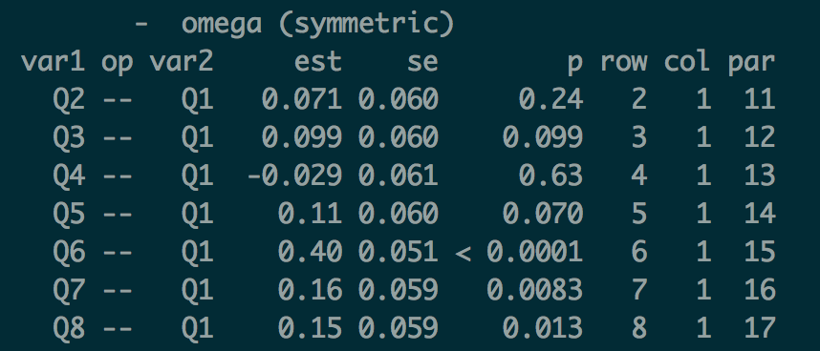
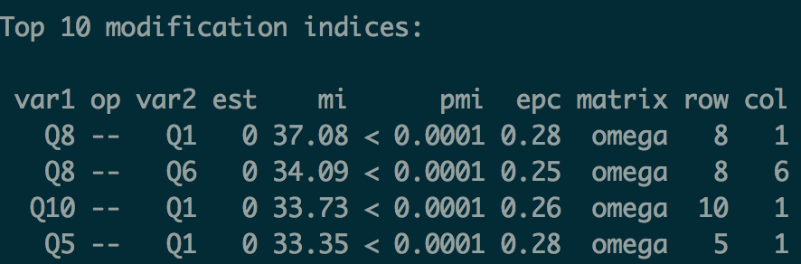
Psychonetrics GGM estimation
library("dplyr")
library(”qgraph")
# Observed variables:
obsvars <- c("Q1", "Q2", "Q3", "Q4", "Q5", "Q6", "Q7", "Q8", "Q9", "Q10")
# Form GGM model:
ggm1 <- ggm(StarWars, vars = obsvars)
# Run model:
ggm1 <- ggm1 %>% runmodel
# Check parameters:
ggm1 %>% parameters
# Prune non-significant:
ggm1 <- ggm1 %>%
prune(adjust = "fdr", alpha = 0.01)
# Check modification indices:
ggm1 %>% MIs
# Stepup estimation:
ggm1 <- ggm1 %>% stepup(criterion = "bic", alpha = 0.05)

Slide 11
Psychonetrics GGM estimation using dplyr pipe:
# Form GGM model:
ggm1 <- ggm(StarWars, vars = obsvars)
# Run model and estimate structure:
ggm1 <- ggm1 %>% runmodel %>%
prune(adjust = "fdr", alpha = 0.01) %>%
stepup(criterion = "bic", alpha = 0.05)
Model inspection:
# Model fit:
ggm1 %>% fit
# Obtain network:
net1 <- getmatrix(ggm1, "omega")
# Plot (save to PDF):
qgraph(net1,
layout = "spring",
theme = "colorblind",
labels = obsvars,
filetype = "pdf",
filename = "psychonetrics_GGM")

Slide 12
Alternatively use bootnet estimated network:
# GGM model 2:
library("bootnet")
mod <- estimateNetwork(StarWars[,obsvars], default = "ggmModSelect")
structure <- 1*(mod$graph!=0)
# Form second GGM model with fixed structure:
ggm2 <- ggm(StarWars, omega = structure, vars = obsvars)
# Estimate GGM:
ggm2 <- ggm2 %>% runmodel
# Obtain network:
net2 <- getmatrix(ggm2, "omega")

Slide 13
Plotting two networks with the same layout
# Obtain average layout (function from qgraph)
Layout <- averageLayout(net1,net2)
# plot both networks:
layout(t(1:2))
qgraph(net1, layout = Layout, theme = "colorblind", title = "psychonetrics",
labels = obsvars)
qgraph(net2, layout = Layout, theme = "colorblind", title = "ggmModSelect",
labels = obsvars)

Slide 14
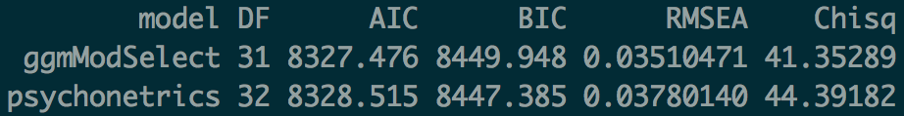
Statistically compare two models
compare(psychonetrics = ggm1, ggmModSelect = ggm2)

Slide 15
Inclusion of latent variables
Latent network model
Residual network model
Epskamp, S., Rhemtulla, M. T., & Borsboom, D. (2017). Generalized Network Psychometrics: Combining Network and Latent Variable Models. Psychometrika, 82(4), 904–927.

Slide 16
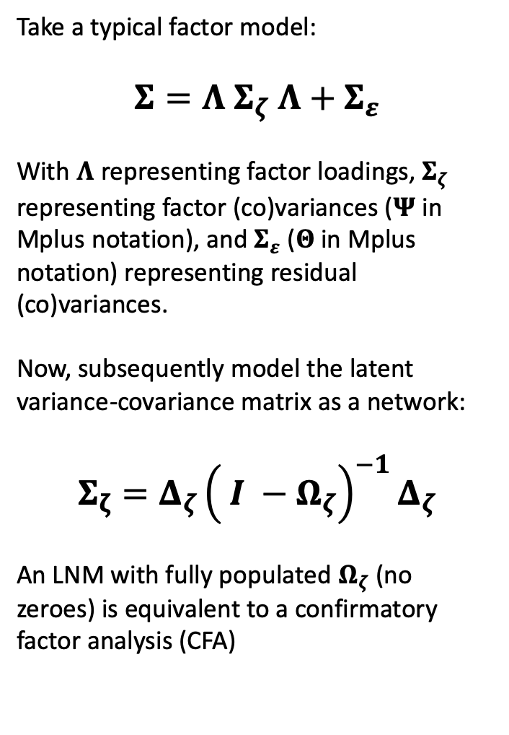
Latent network modeling (LNM)
Take a typical factor model:
$$Σ=Λ Σ_{ζ} Λ+Σ_{ε}$$
With $Λ$ representing factor loadings, $Σ_{ζ}$ representing factor (co)variances ($Ψ$in Mplus notation), and $Σ_{ε}$ ($Θ$in Mplus notation) representing residual (co)variances.
Now, subsequently model the latent variance-covariance matrix as a network:
$$Σ_{ζ}=Δ_{ζ}{\left.\left( I −Ω_{ζ}\right.\right)}^{−1}Δ_{ζ}$$
An LNM with fully populated $Ω_{ζ}$ (no zeroes) is equivalent to a confirmatory factor analysis (CFA)

Slide 17
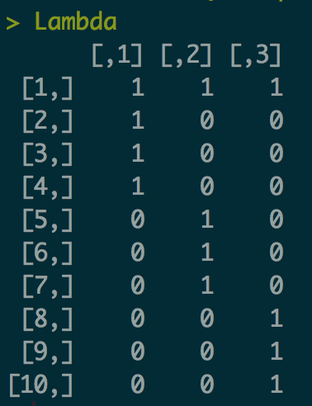
Confirmatory factor analysis in psychonetrics
# Factor loadings matrix:
Lambda <- matrix(0, 10, 3)
Lambda[1:4,1] <- 1
Lambda[c(1,5:7),2] <- 1
Lambda[c(1,8:10),3] <- 1
# Latents:
latents <- c("Prequels","Original","Sequels")
# Make CFA model:
cfamod <- lvm(StarWars, lambda = Lambda, vars = obsvars,
identification = "variance", latents = latents)
# Run model:
cfamod <- cfamod %>% runmodel

Slide 18
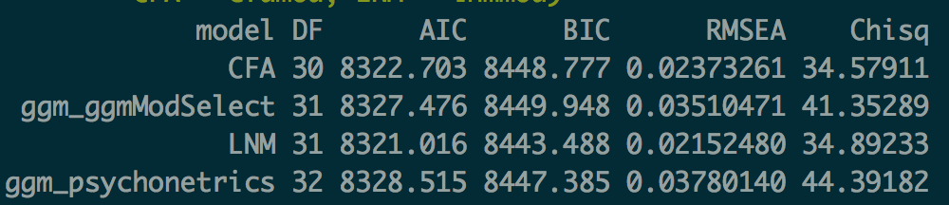
Latent network model
# Latent network:
lnmmod <- lnm(StarWars, lambda = Lambda, vars = obsvars,
identification = "variance", latents = latents)
# Run model and estimate latent structure:
lnmmod <- lnmmod %>% runmodel %>%
prune(adjust = "fdr", alpha = 0.01) %>%
stepup(criterion = "bic", alpha = 0.05)
# Compare all models:
compare(ggm_psychonetrics = ggm1, ggm_ggmModSelect = ggm2,
CFA = cfamod, LNM = lnmmod)

Slide 20
NETWORK BASED ADAPTIVE ASSESSMENT

Slide 21
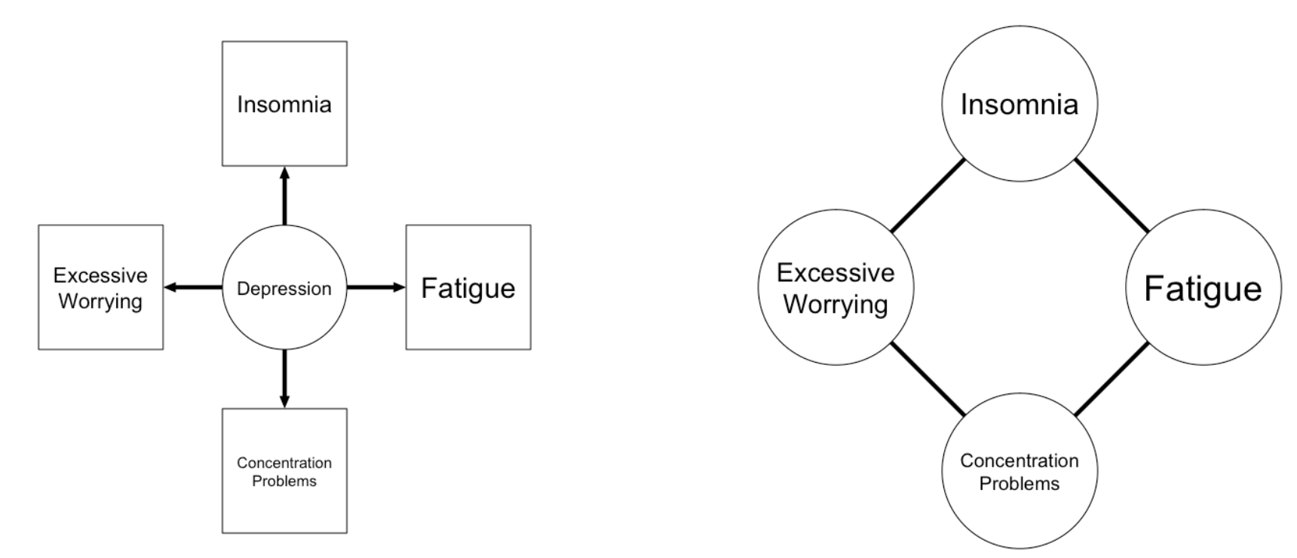
Measurement from a network perspective

Slide 22

Are you tired?
yes no

Slide 23
Are you tired?
yes no
Are you tired?
yes
Do you sleep well?
yes no
Tired
= yes

Slide 24
Are you tired?
yes no

Slide 25
Are you tired?
yes no
Are you tired?
no
Are you tense?
yes no
Tired
= no

Slide 26
Data & app: https://undercoversapp.com/
Thanks to: Theresa Wallner & Sophia von Stockert

Slide 30
...

Slide 32
Meta-analysis
With Adela Isvoranu &
Mike Cheung

Slide 33
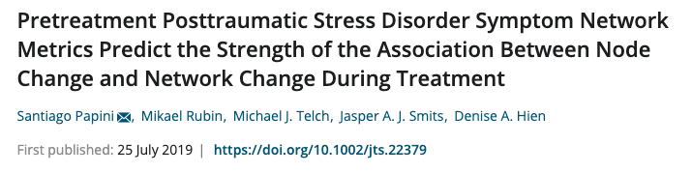
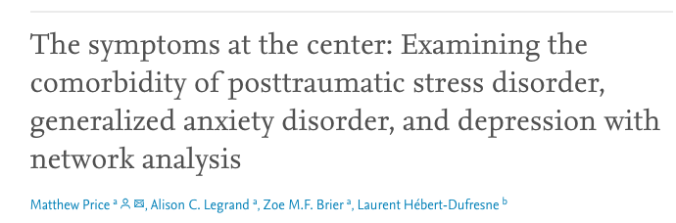


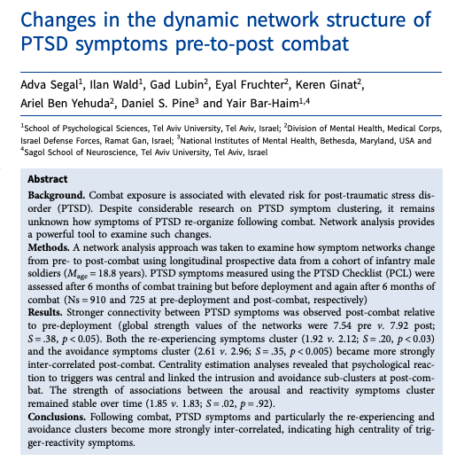


Aggregating Studies

Slide 34
Meta Analysis
Meta-analytic Gaussian Network Aggregation (MAGNA)
  Based on meta-analytic SEM (metaSEM)
Allows for aggregating multiple studies
  Estimate 1 pooled network model (GGM)
  Estimate random effects due to study effects
Beta version implemented in psychonetrics!
Sample correlations of study =
homogenous correlation structure (GGM) +
random effect for study domain +
sample error

Slide 35
MAGNA applied to PTSD
Currently collecting data from PTSD studies for applying MAGNA
Identified 37 studies on network analysis
20 studies already supplied needed data or list data online
Aim is to estimate a pooled network of PTSD symptoms, as well as scope of heterogeneity across study domains.
Paper invited for Psychometrika special issue!

Slide 36
Internship!
I am looking for someone who wishes to do an internship with me on these technical topics!
  psychonetrics extensions
    C++ speedups / robust estimators / Ising models / structural VAR + gimme / …
  Network-based adaptive assessment
  Software maintenance + extensions
  Meta-analysis

Slide 37
Thank you for your attention!
Publications & presentations:
www.sachaepskamp.com
Facebook group: facebook.com/groups/PsychologicalDynamics

