Slide 1

The Network Perspective of Psychology:
From Exploration to Theory Formation
Sacha Epskamp – NUS Seminar 05/02/2020
Sacha Epskamp
www.sachaepskamp.com

Slide 2
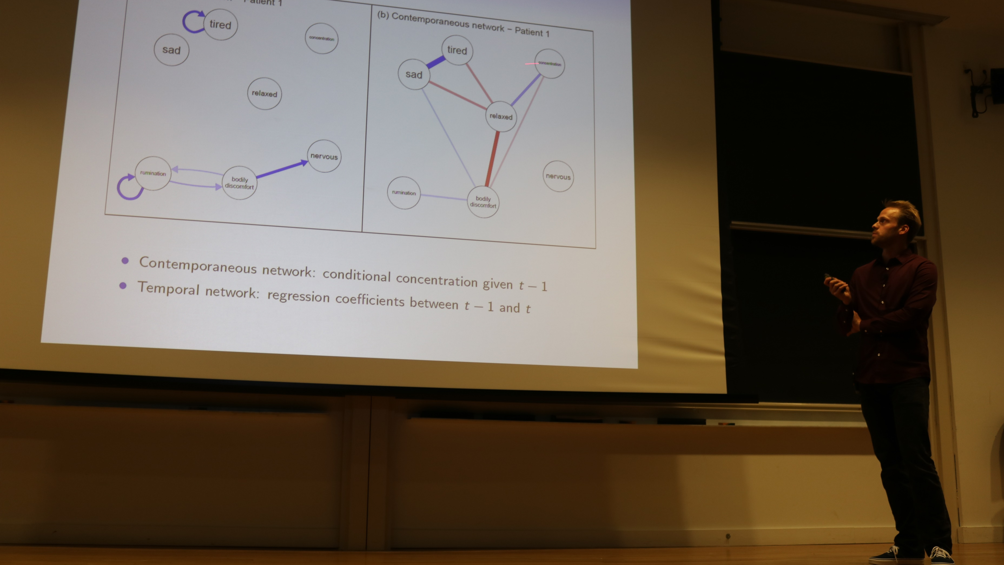


Assistant Professor in Psychological Methods
Teaching on multivariate statistics
Head of the psychonetrics lab group
  psychonetrics.org
PhD Supervision:
  Project on network analysis in clinical practice with Groningen Medical Center
  Two projects in psychological methods
Principal Investigator
Multi-disciplinary institute for complexity approaches to studying mental health problems
PhD Supervision:
  Project on time-series modelling of patients with Communication Science
  Project on computational modelling of addiction with Computational Science
Editorships: Associate editor for Psychological Methods & Psychometrika and guest editor for the European Journal of Personality & the European Journal of Psychological Assessment.
Software: https://github.com/SachaEpskamp
Sacha Epskamp
www.sachaepskamp.com

Slide 3




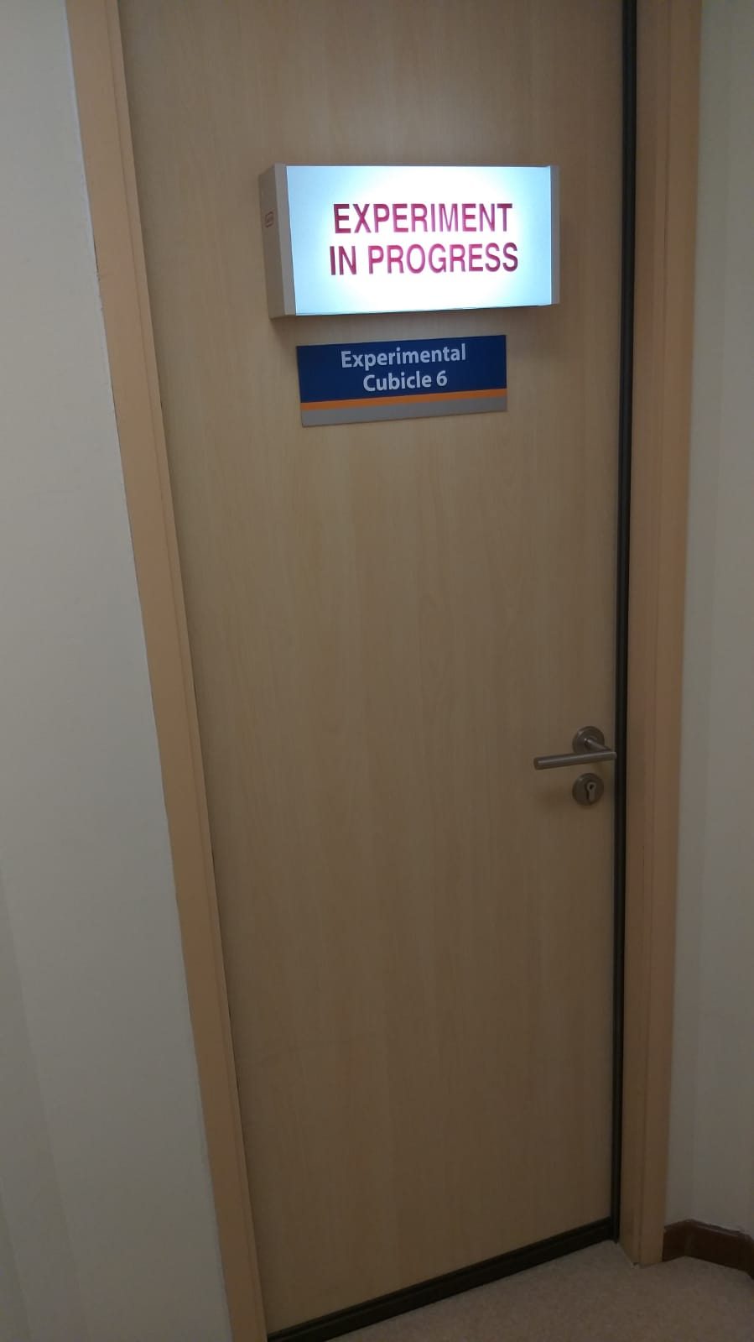
2015
Nanyang Technological University: Complexity Institute
2019
National University of Singapore: Department of Psychology
Sacha Epskamp
www.sachaepskamp.com

Slide 4

Psychology as a Complex System
Sacha Epskamp
www.sachaepskamp.com

Slide 5
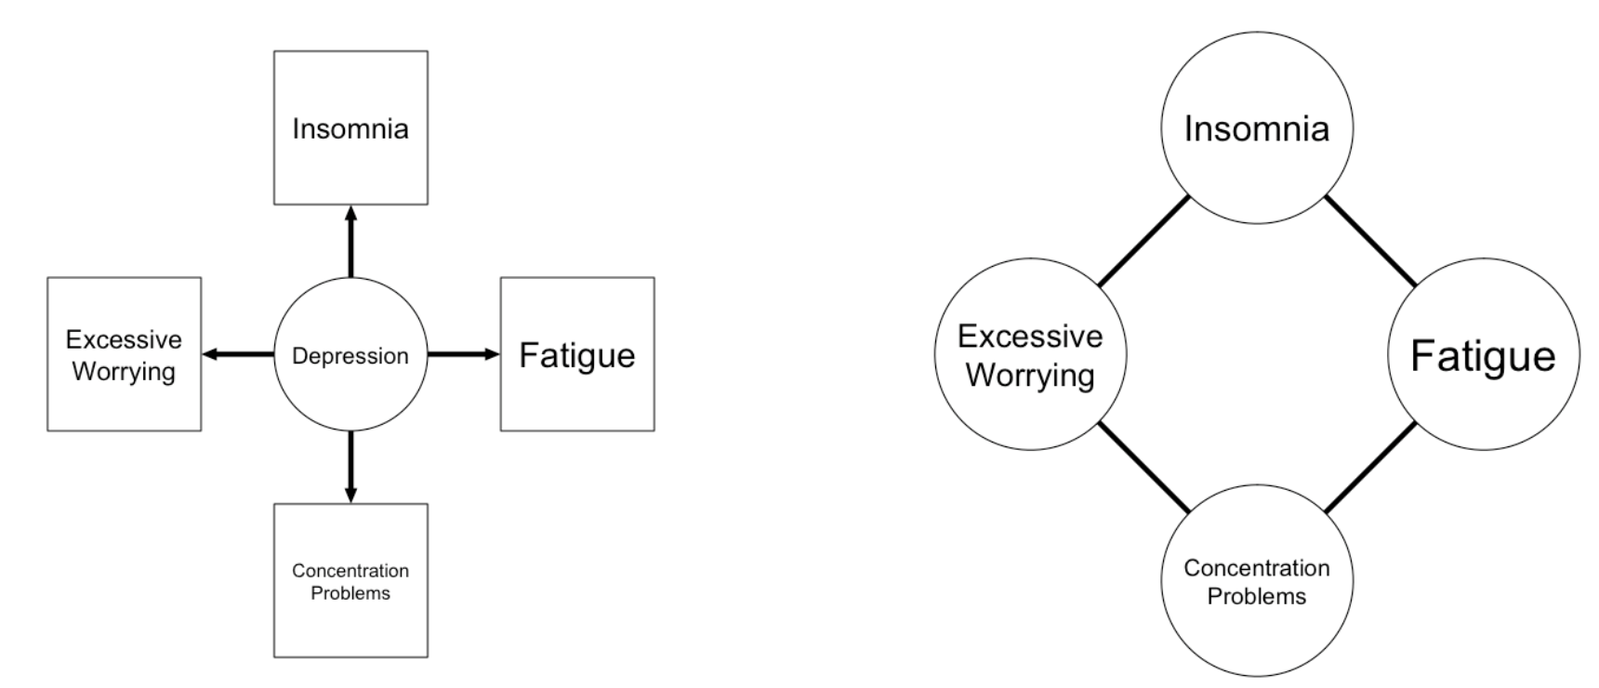
Psychology as a Complex System
Sacha Epskamp
www.sachaepskamp.com

Slide 6
Psychology as a Complex System
Sacha Epskamp
www.sachaepskamp.com

Slide 7

Sacha Epskamp
www.sachaepskamp.com

Slide 8
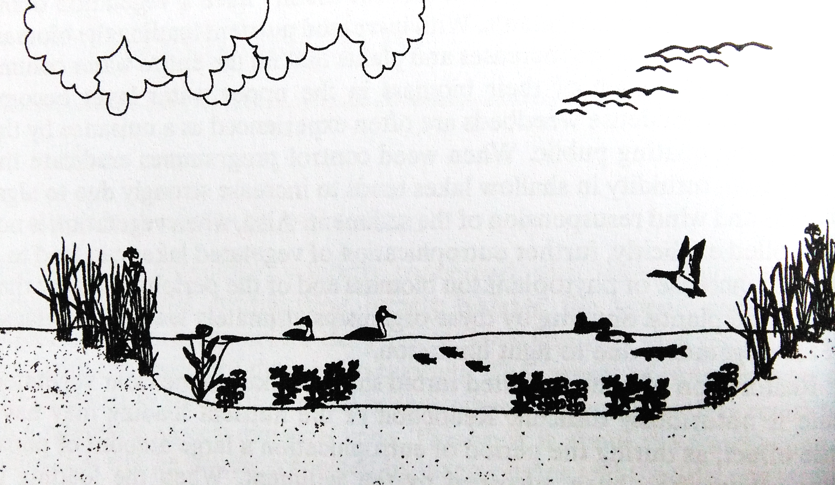
Scheffer, M. (2004). Ecology of shallow lakes. Berlin, Germany: Springer Science & Business Media.
Sacha Epskamp
www.sachaepskamp.com

Slide 9
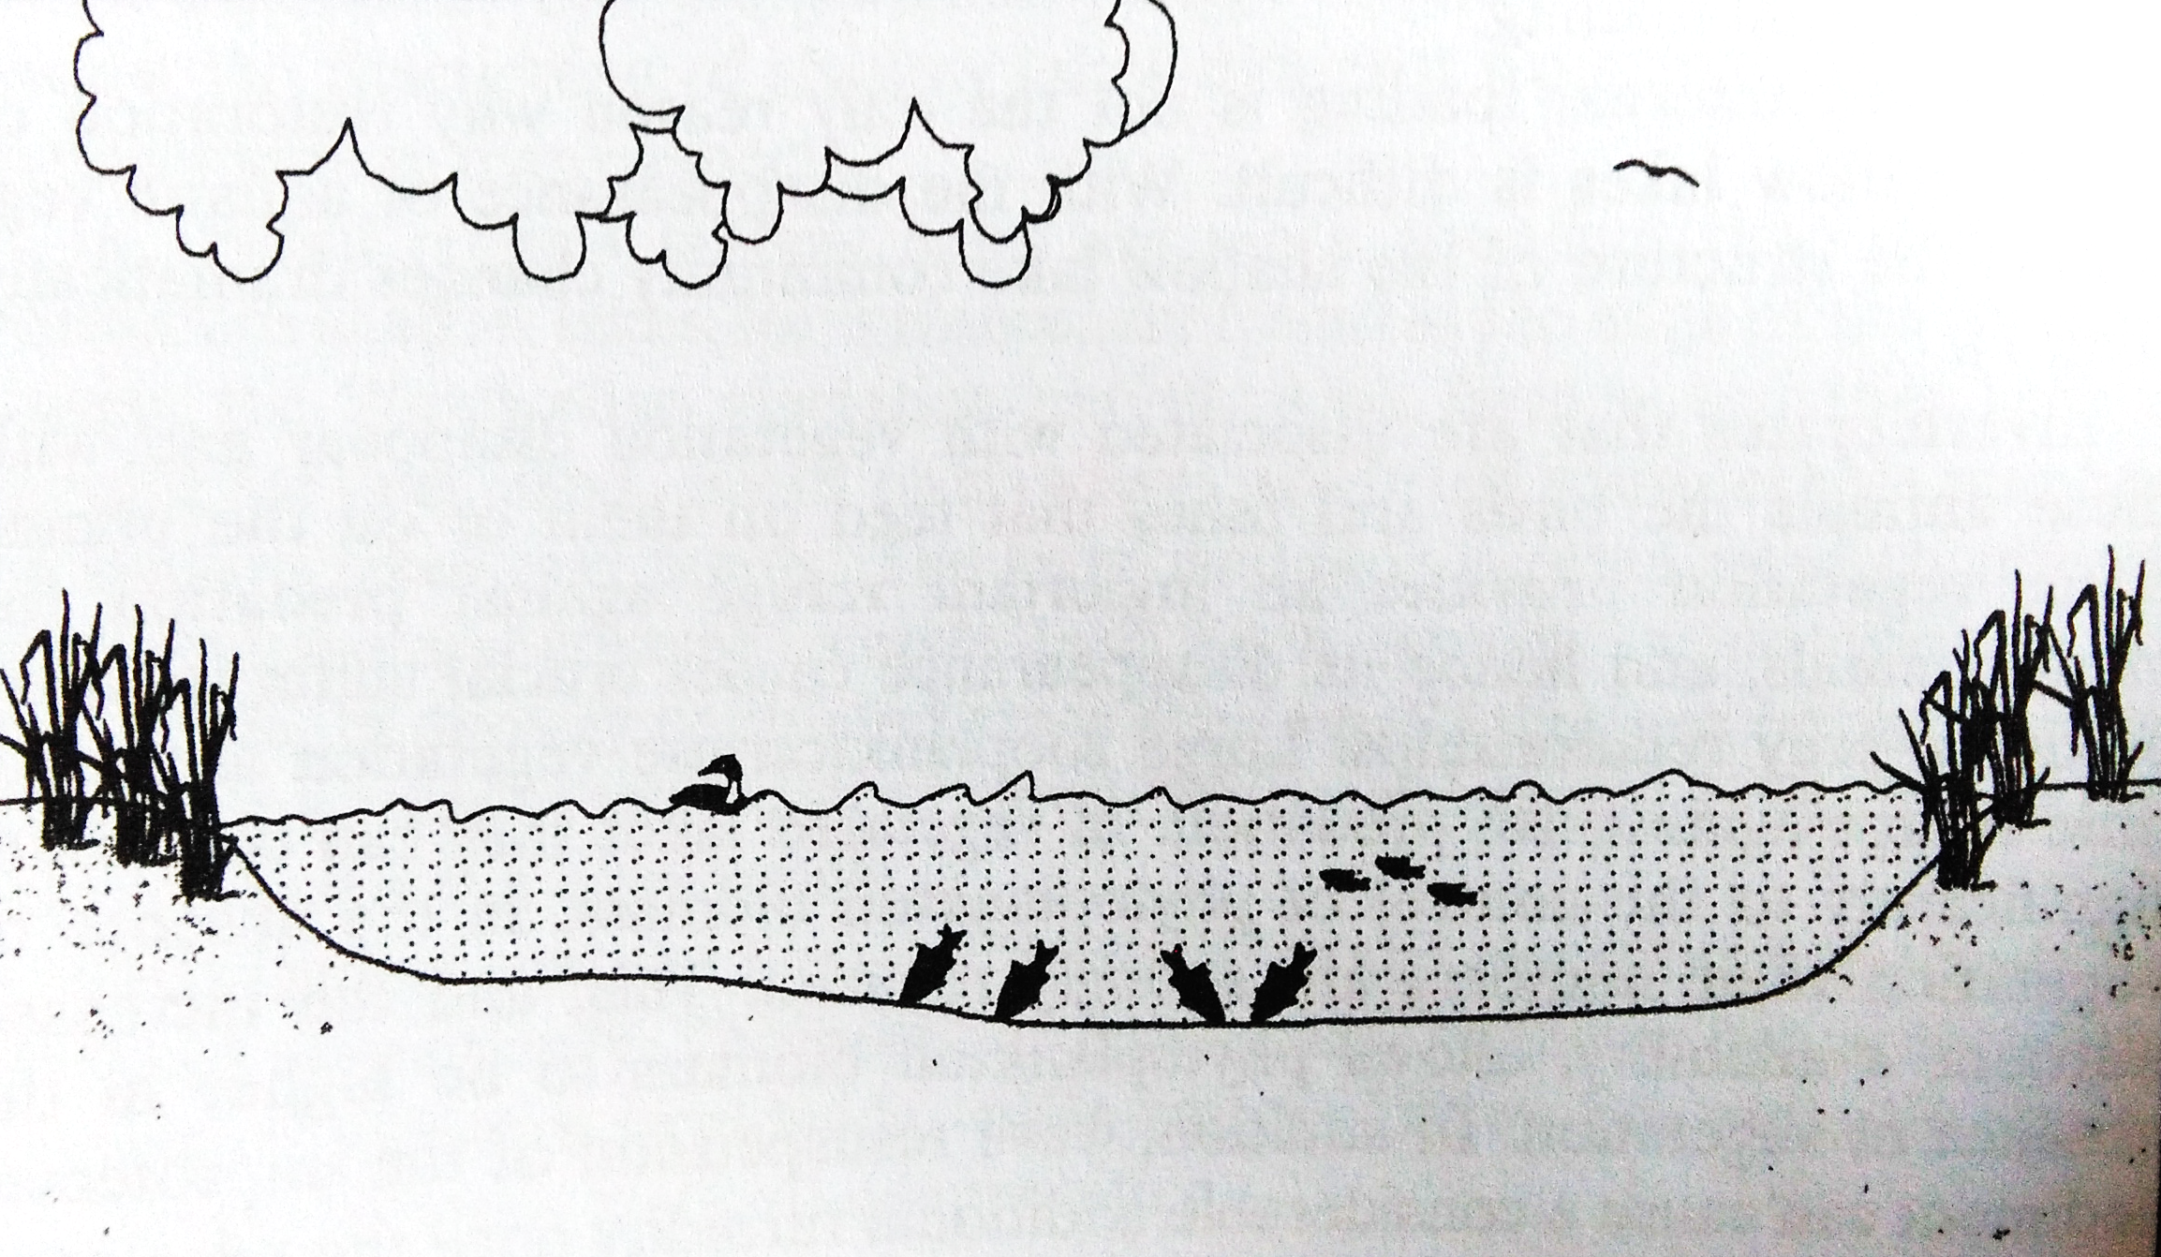
Scheffer, M. (2004). Ecology of shallow lakes. Berlin, Germany: Springer Science & Business Media.
Sacha Epskamp
www.sachaepskamp.com

Slide 10
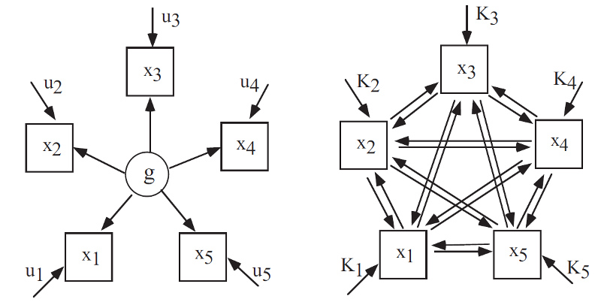
Intelligence
Mutualism
van der Maas, H. L., Dolan, C. V., Grasman, R. P., Wicherts, J. M., Huizenga, H. M., & Raijmakers, M. E. (2006). A dynamical model of general intelligence: The positive manifold of intelligence by mutualism. Psychological Review, 113(4), 842–861. doi: 10.1037/ 0033-295X.113.4.842
Scheffer, M. (2004). Ecology of shallow lakes. Berlin, Germany: Springer Science & Business Media.
Sacha Epskamp
www.sachaepskamp.com

Slide 11

Sacha Epskamp
www.sachaepskamp.com

Slide 12
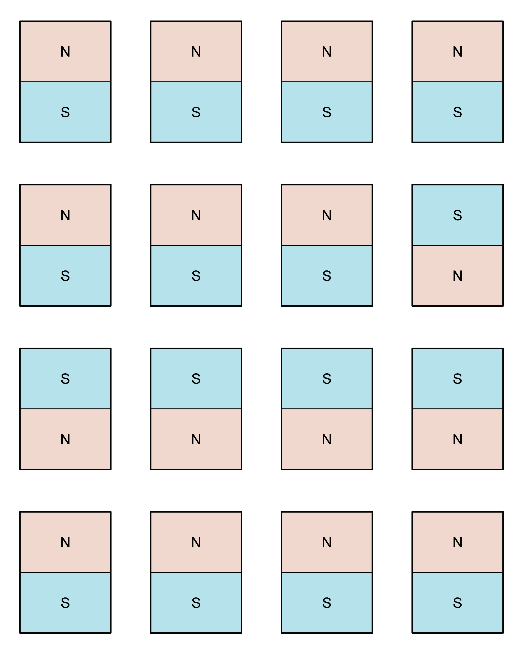
The Ising Model
Sacha Epskamp
www.sachaepskamp.com

Slide 13
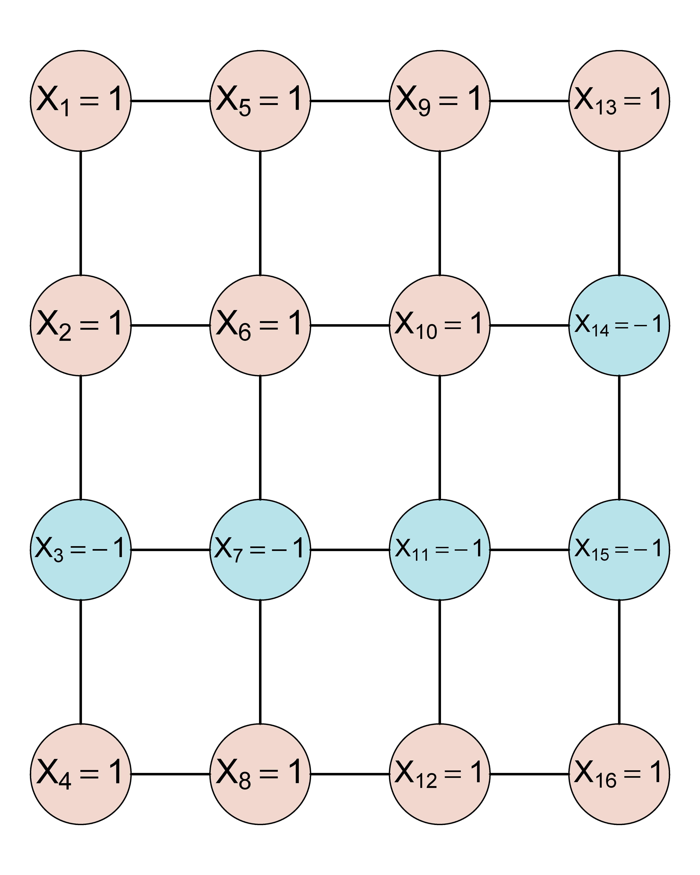
The Ising Model
Sacha Epskamp
www.sachaepskamp.com

Slide 14
The Ising Model
Number of nodes 1
If not too sparse & most interaction are positive
(external input)
(connectivity)
Sacha Epskamp
www.sachaepskamp.com

Slide 15

Sacha Epskamp
www.sachaepskamp.com

Slide 16
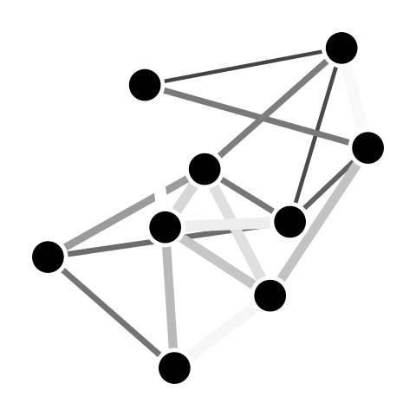
Sacha Epskamp
www.sachaepskamp.com

Slide 17
Cramer, A. O., van Borkulo, C. D., Giltay, E. J., van der Maas, H. L., Kendler, K. S., Scheffer, M., & Borsboom, D. (2016). Major depression as a complex dynamic system. PloS one, 11(12), e0167490.
Sacha Epskamp
www.sachaepskamp.com

Slide 18

Sacha Epskamp
www.sachaepskamp.com

Slide 19
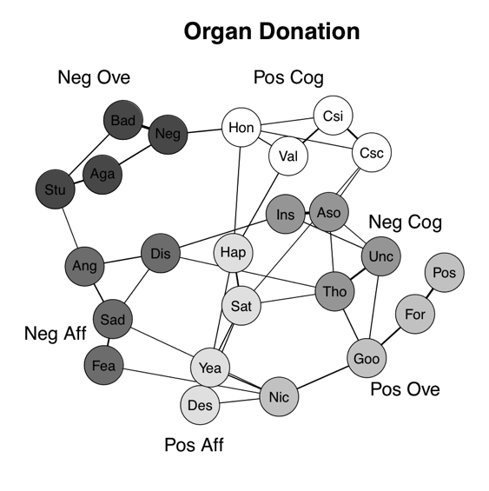

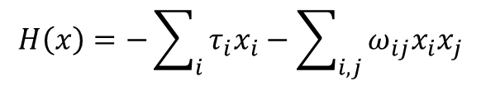
Attitude formation with Ising dynamics
    Nodes X: Attitude elements (beliefs, feelings, behaviors)
    Edges w: interactions (attitude elements re-enforce one-another)
    Thresholds t: dispositions of evaluative reactions based on external information
    Involvement (inverse temperature) b: High = ordered, low = random
$$H\left(x\right)=−\sum_{i}{τ_{i}x_{i}−\sum_{i,j}{ω_{ij}x_{i}x_{j}}}$$
$\text{Pr}(X=x)=\frac{\text{exp}(−βH(x))}{Z}$
Dalege, J., Borsboom, D., van Harreveld, F., van den Berg, H., Conner, M., & van der Maas, H. L. J. (2016). Toward a formalized account of attitudes: The Causal Attitude (CAN) model. Psychological Review, 123, 2-22.
Dalege, J., Borsboom, D., van Harreveld, F., & van der Maas, H. L. (2018b). The Attitudinal Entropy (AE) Framework as a General Theory of Individual Attitudes. Psychological Inquiry, 29(4), 175-193.
Sacha Epskamp
www.sachaepskamp.com

Slide 20


Sacha Epskamp
www.sachaepskamp.com

Slide 21
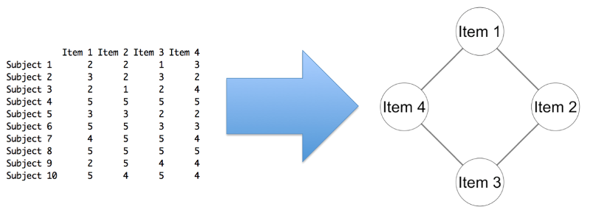
Sacha Epskamp
www.sachaepskamp.com

Slide 22
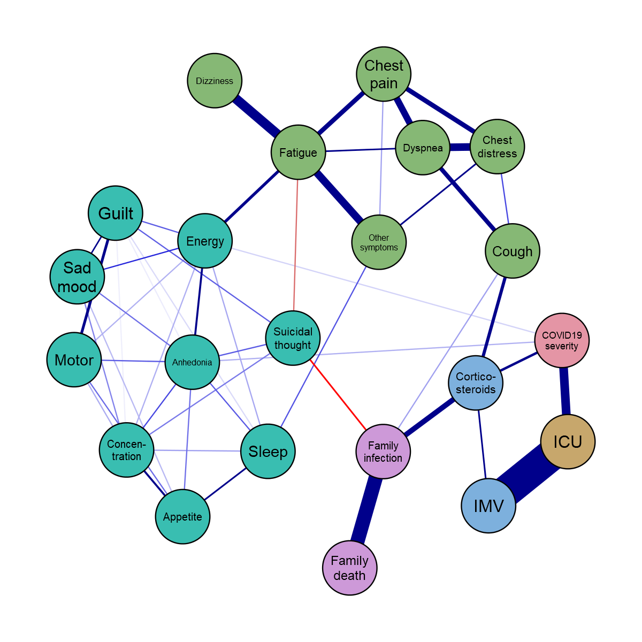
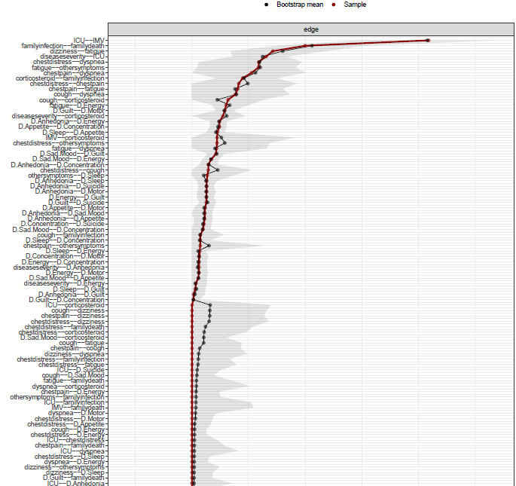

Cross-sectional Data
Sacha Epskamp
www.sachaepskamp.com
Time-series Data

Slide 23
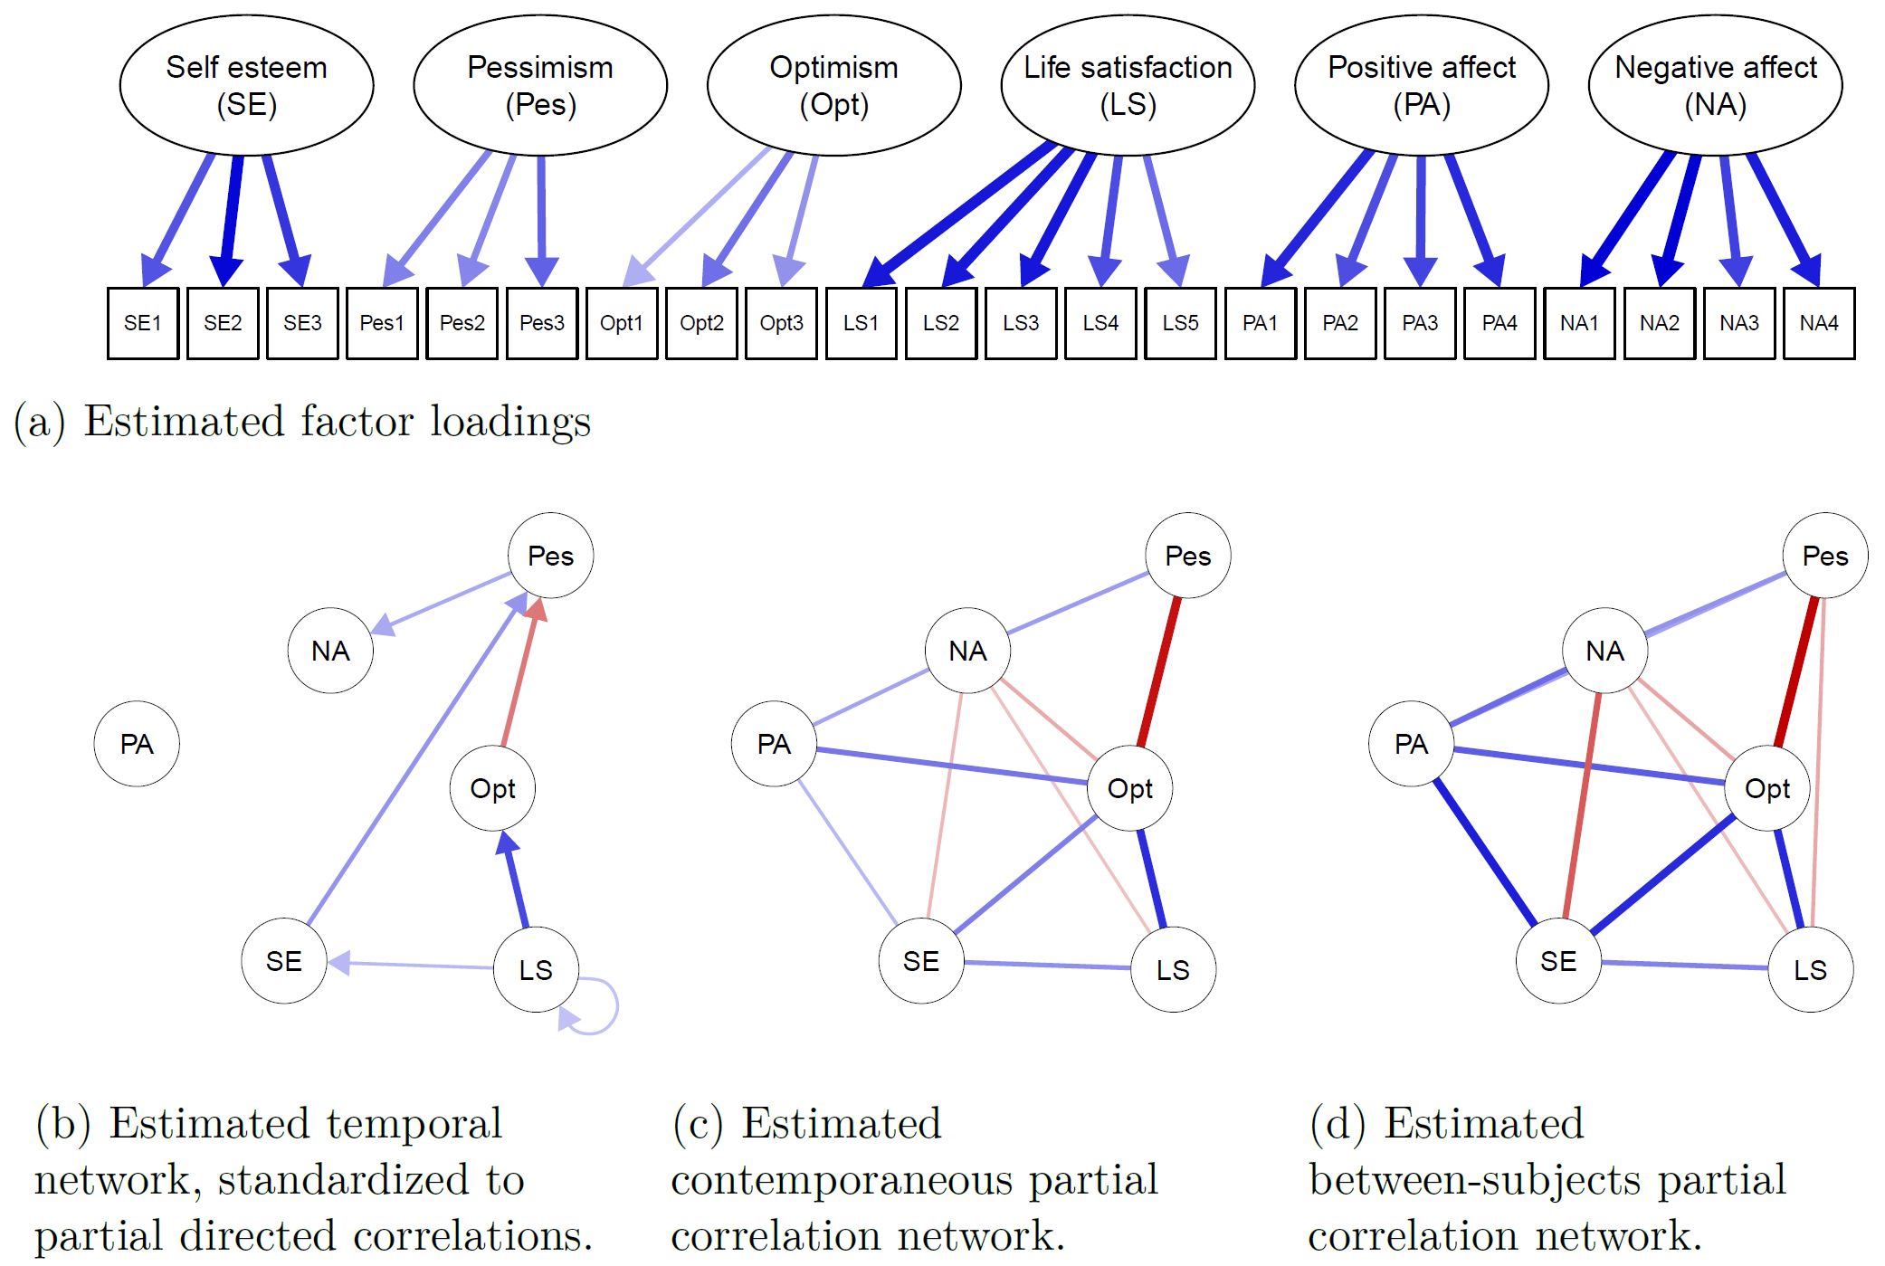
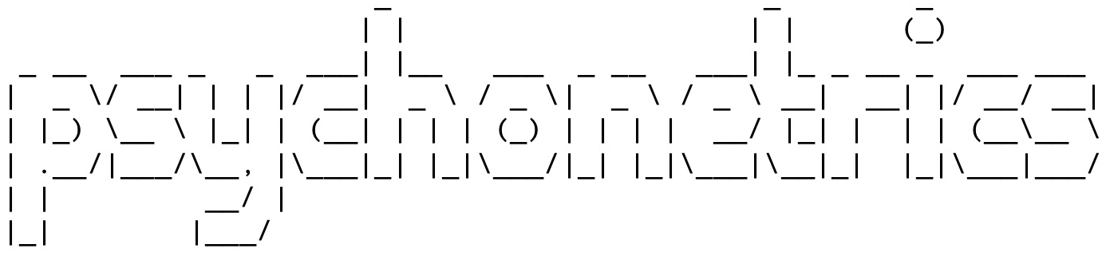
Sacha Epskamp
www.sachaepskamp.com

Slide 24
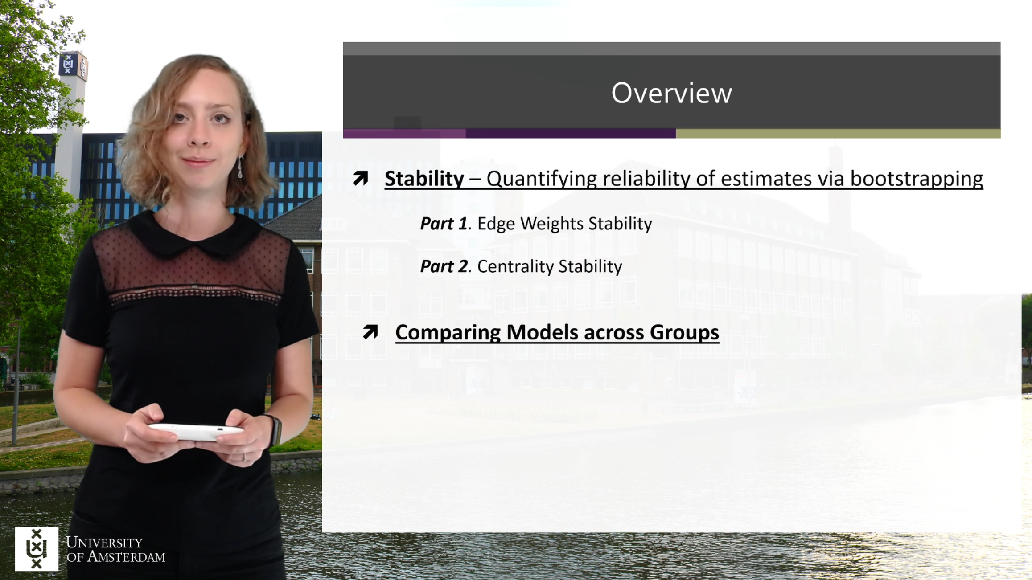
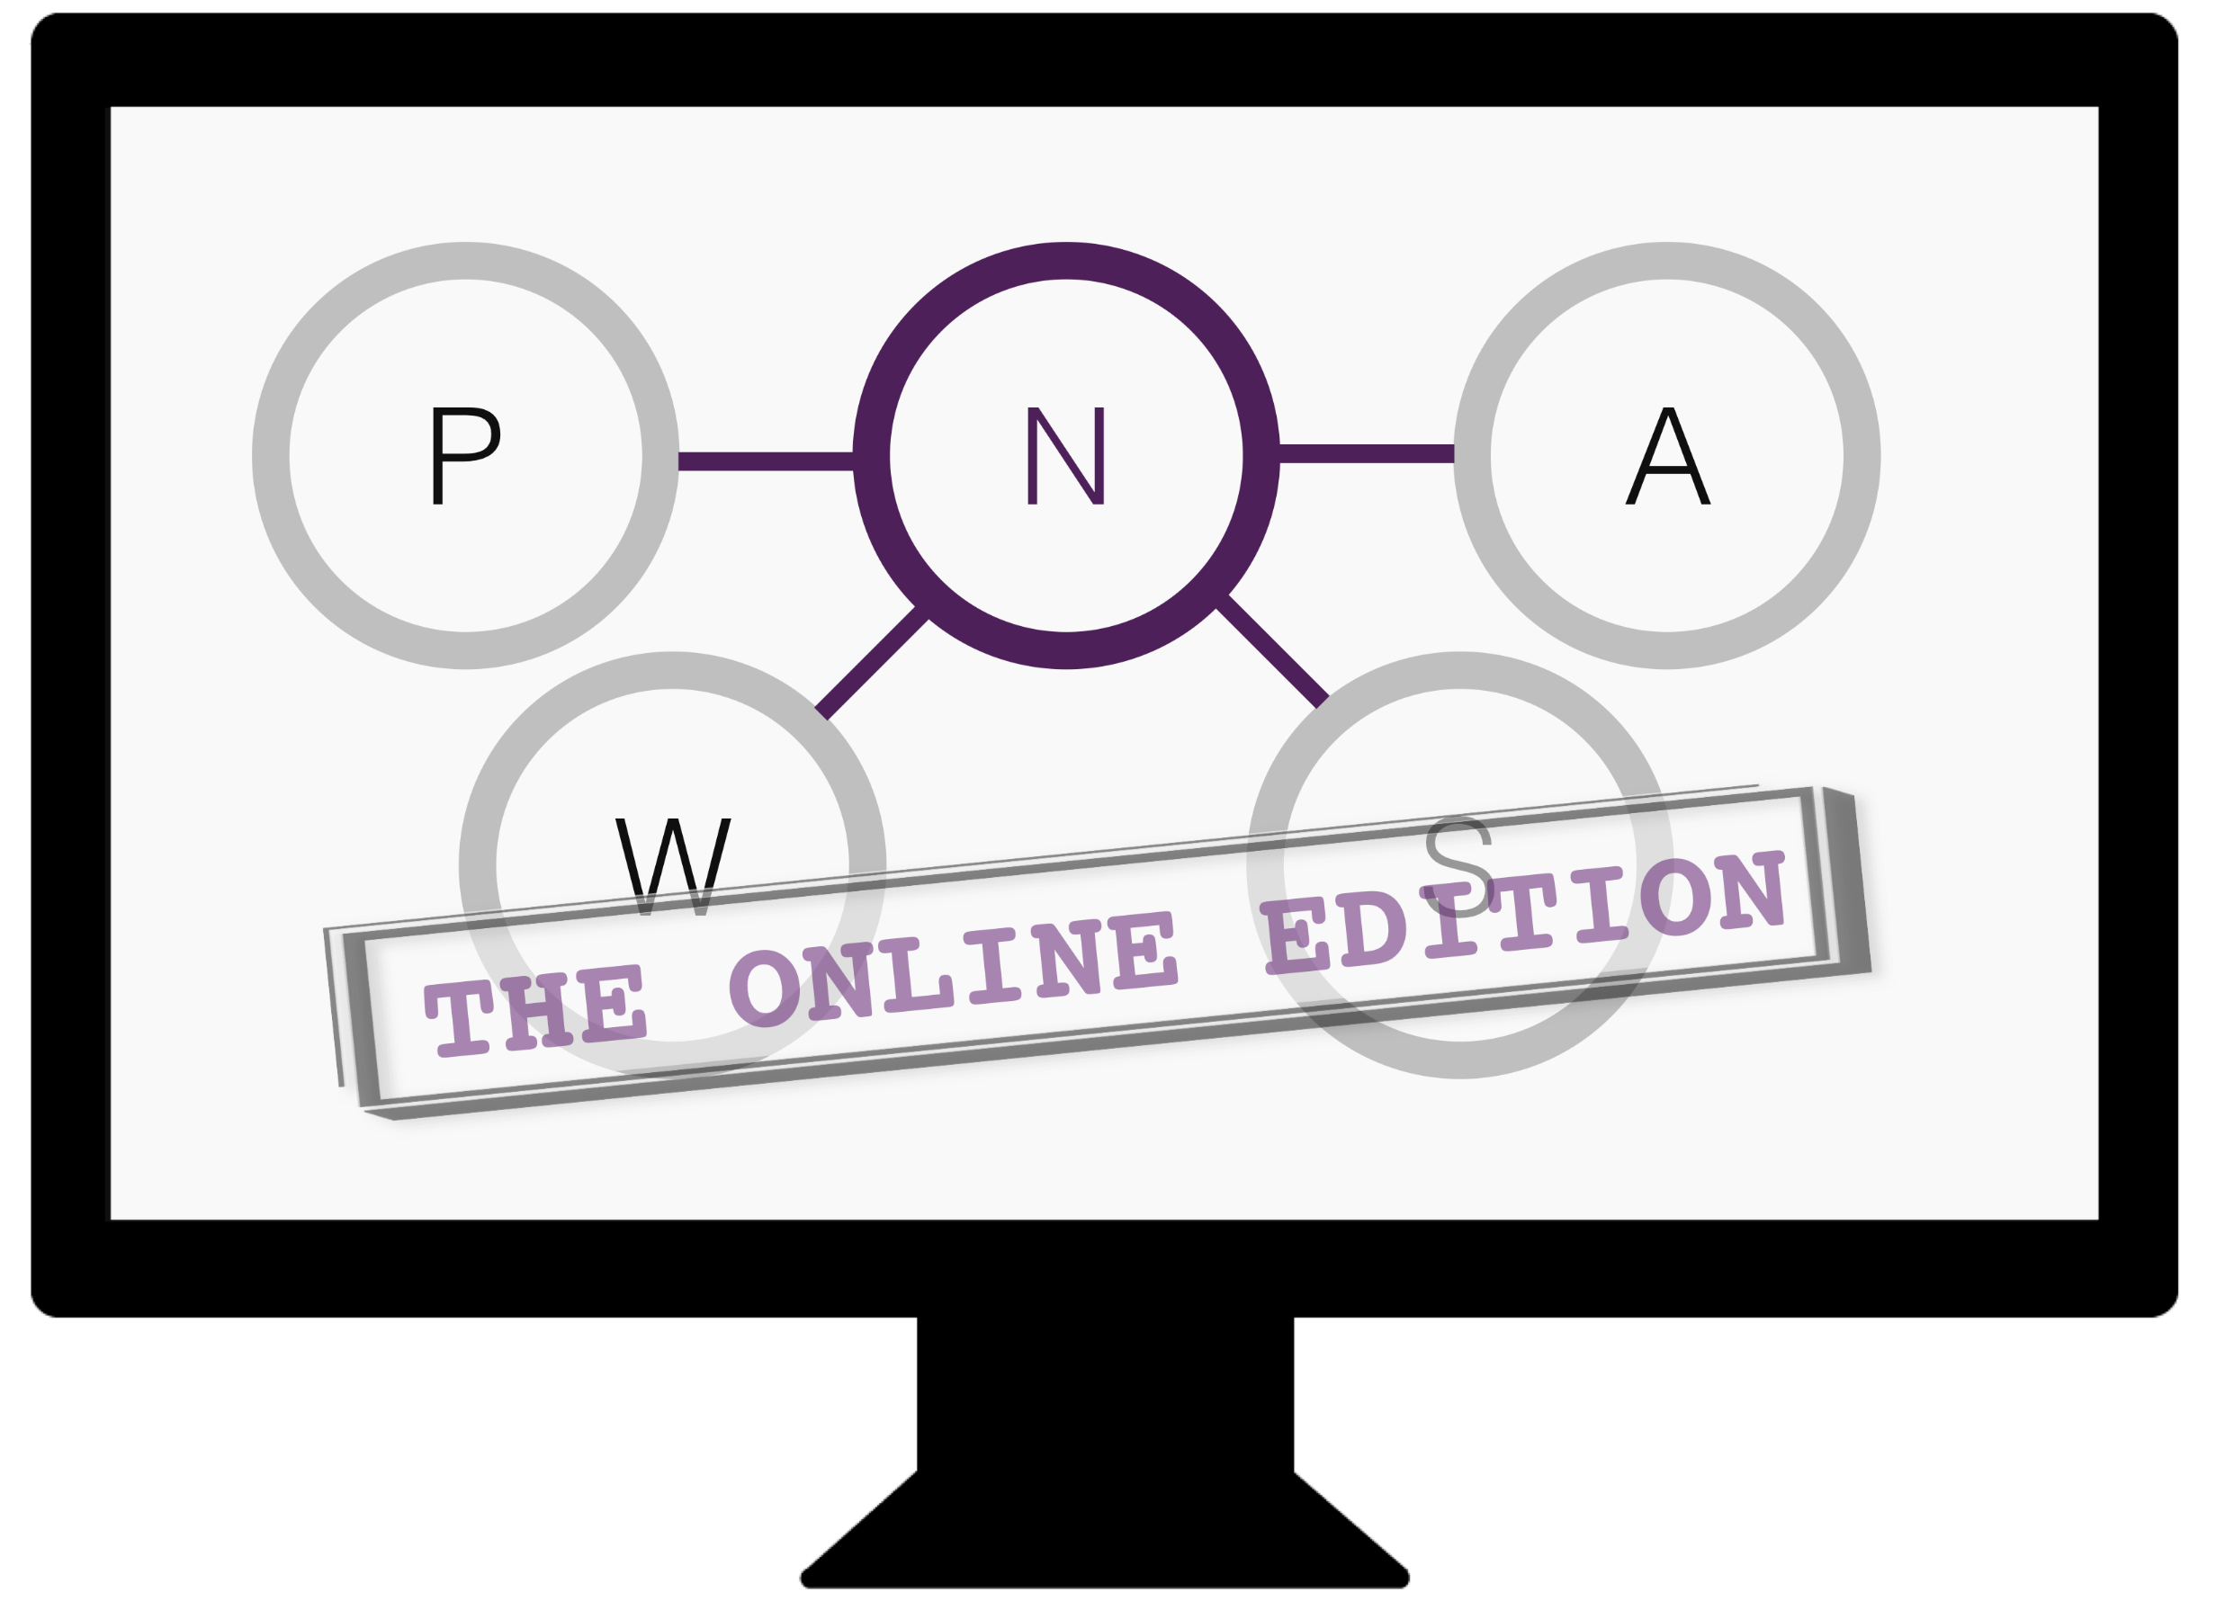
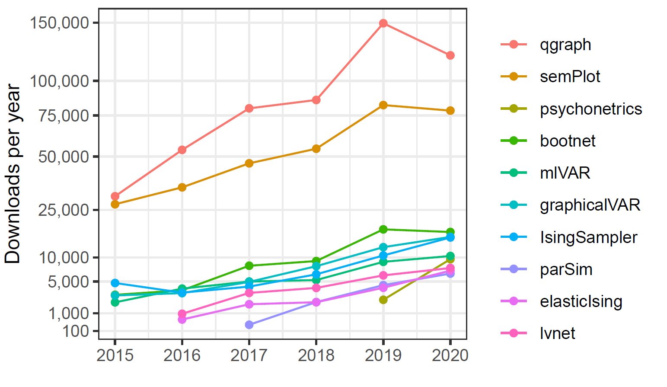

Methodological / tutorial papers I main-authored:
Journal of Statistical Software (DOI:10.18637/jss.v048.i04) – 1249 citations
Behavior Research Methods (DOI:10.3758/s13428-017-0862-1) – 805 citations
Psychological Methods (DOI:10.1037/met0000167) – 513 citations
Multivariate Behavioral Research (DOI:10.1080/00273171.2018.1454823) – 247 citations
Handbook chapter (arXiv:1609.02818) – 228 citations
Psychometrika (DOI:10.1007/s11336-017-9557-x) – 214 citations
Papers
Workshops
Software
We hosted 10 summer/winter schools with 30 – 55 participants
  Organized by Adela Isvoranu
We have been invited to give workshops all over the world
  e.g., USA, Brazil, EU, Switzerland, Taiwan
We are currently writing a textbook
  Contract with Taylor & Francis
Sacha Epskamp
www.sachaepskamp.com
github.com/SachaEpskamp

Slide 25


Sacha Epskamp
www.sachaepskamp.com

Slide 26

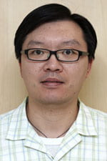
PTSD Meta-Analysis
Visit to NUS to start work on empirical meta-analysis of PTSD samples used for network analysis (1) and methodology for meta-analytic psychological network analysis (2).
33 articles (up to 2019) included leading to 52 samples, total sample size of n = 29,561.
Data analyzed using Meta-analytic Gaussian Network Aggregations (MAGNA) implemented in psychonetrics.
(1) Isvoranu, Epskamp & Cheung: Network Models of Post-traumatic Stress Disorder: A Meta-analysis (psyarxiv.com/8k4u6/) – in revision for the Journal of Abnormal Psychology.
(2) Epskamp, Isvoranu & Cheung: Meta-analytic Gaussian Network Aggregation (psyarxiv.com/236w8/) – Accepted (pending revision) in Psychometrika.
Adela Isvoranu
Mike Cheung
Sacha Epskamp
www.sachaepskamp.com

Slide 27
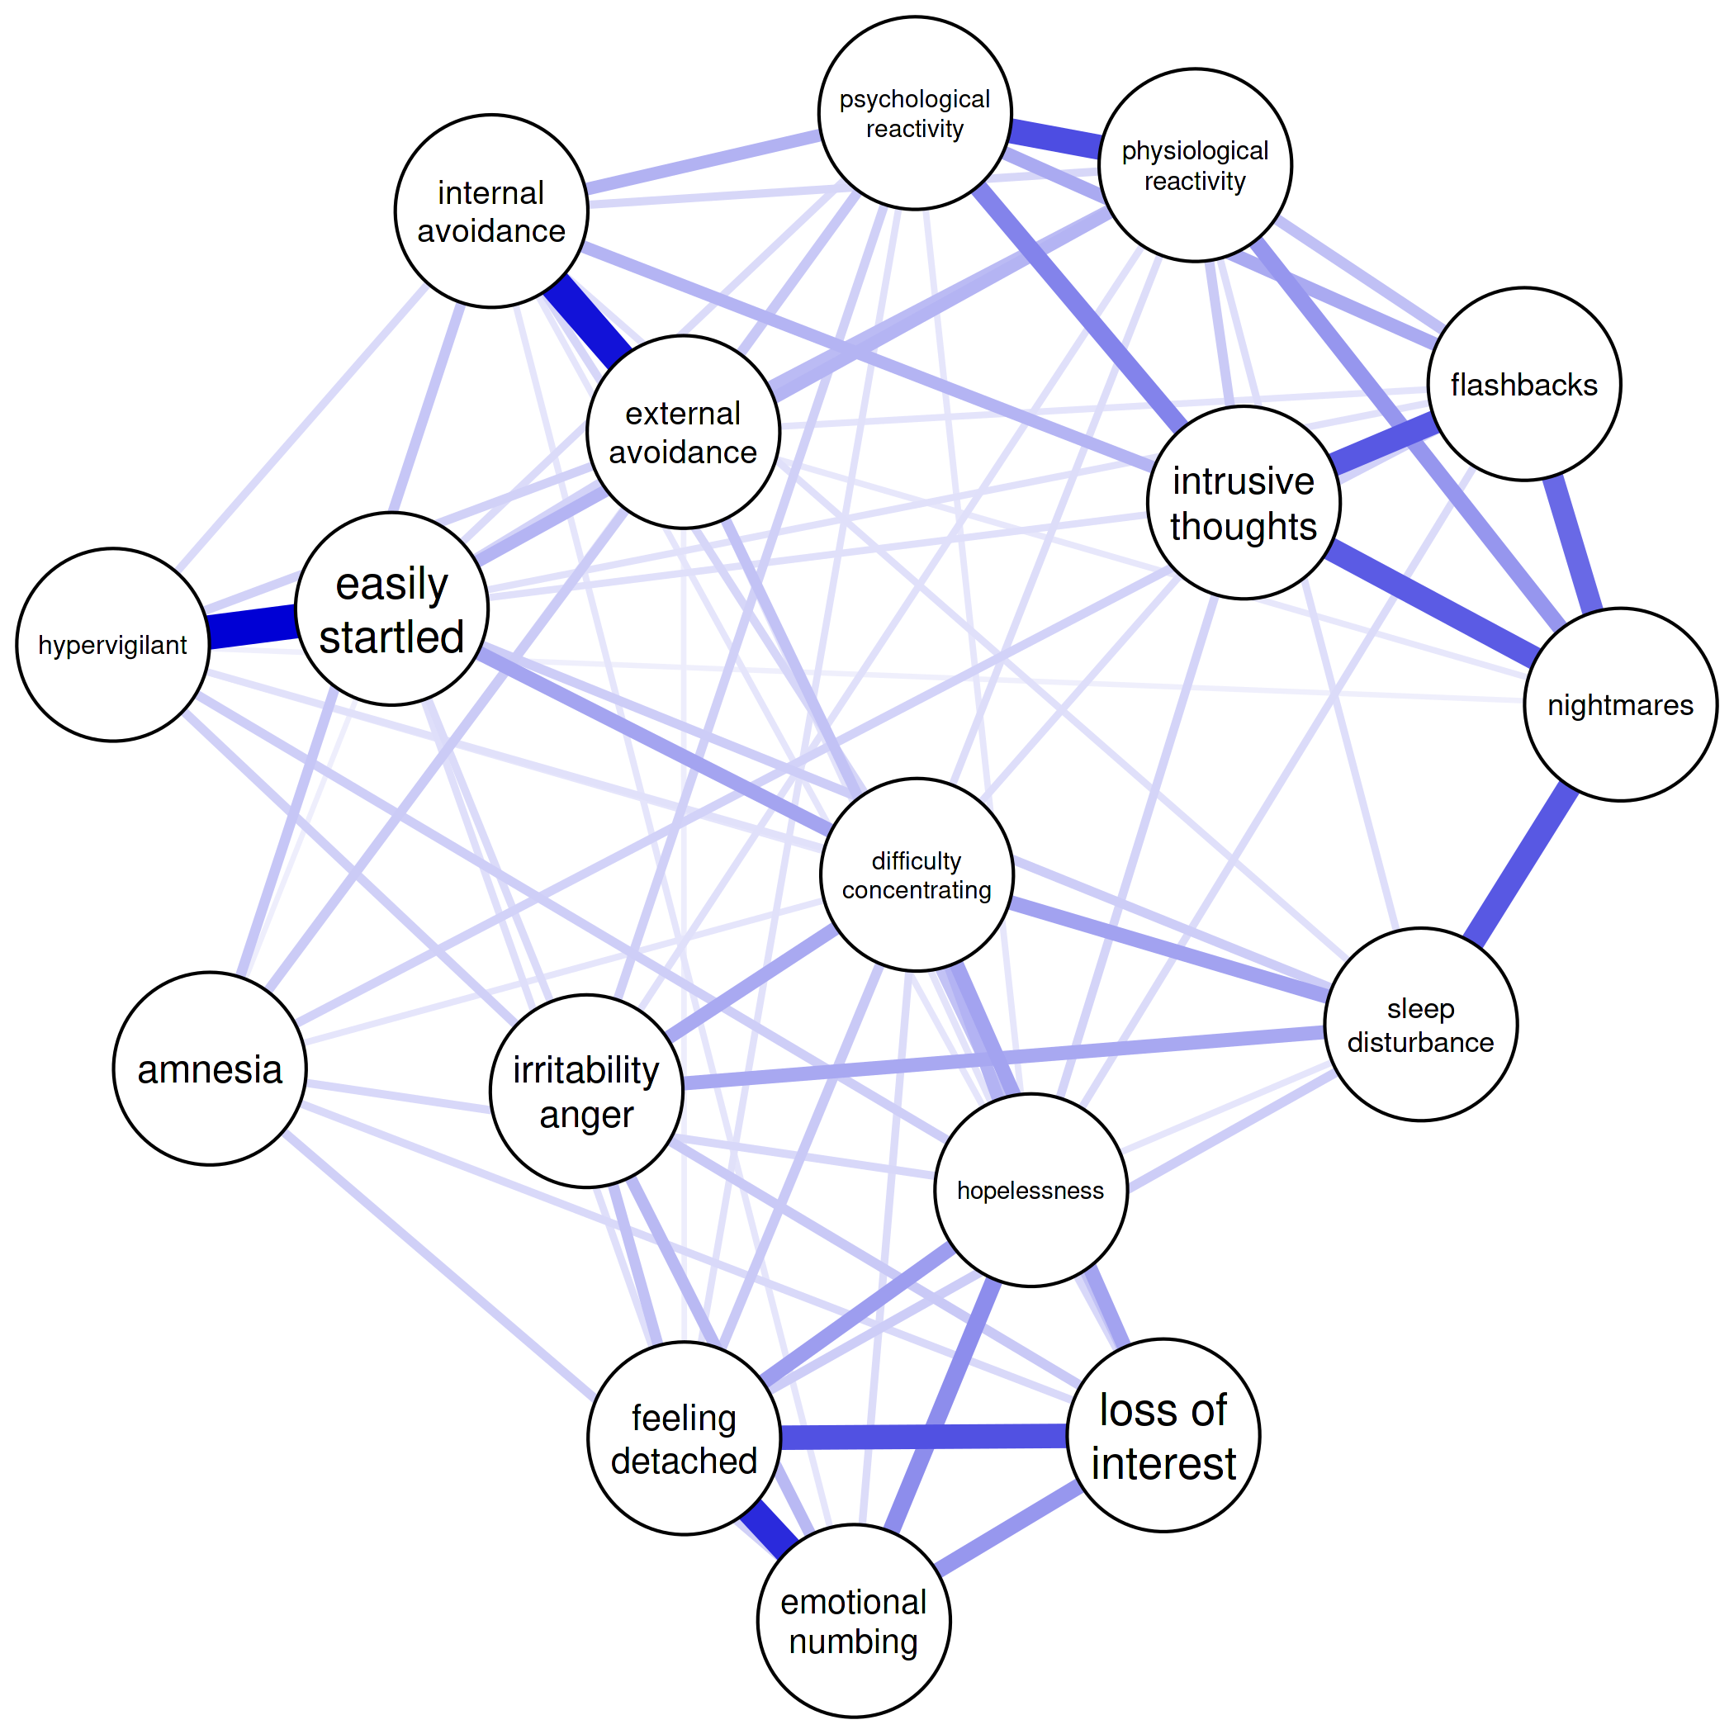
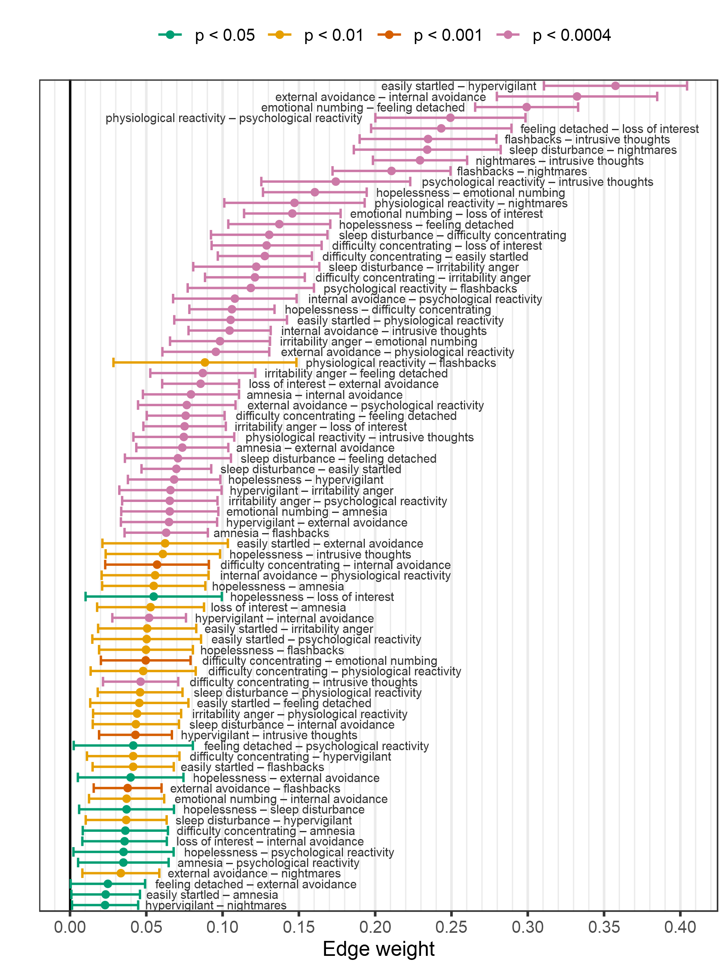
Estimated pooled network
Sacha Epskamp
www.sachaepskamp.com

Slide 28
Estimated pooled network
Reactivity
Sacha Epskamp
www.sachaepskamp.com

Slide 29
Estimated pooled network
Avoidance
Reactivity
Sacha Epskamp
www.sachaepskamp.com

Slide 30
Estimated pooled network
Avoidance
Reactivity
Startle / vigilant
Sacha Epskamp
www.sachaepskamp.com

Slide 31
Estimated pooled network
Avoidance
Reactivity
Startle / vigilant
Reliving
Sacha Epskamp
www.sachaepskamp.com

Slide 32
Estimated pooled network
Avoidance
Reactivity
Startle / vigilant
Reliving
Arousal
Sacha Epskamp
www.sachaepskamp.com
Cognition / mood

Slide 33
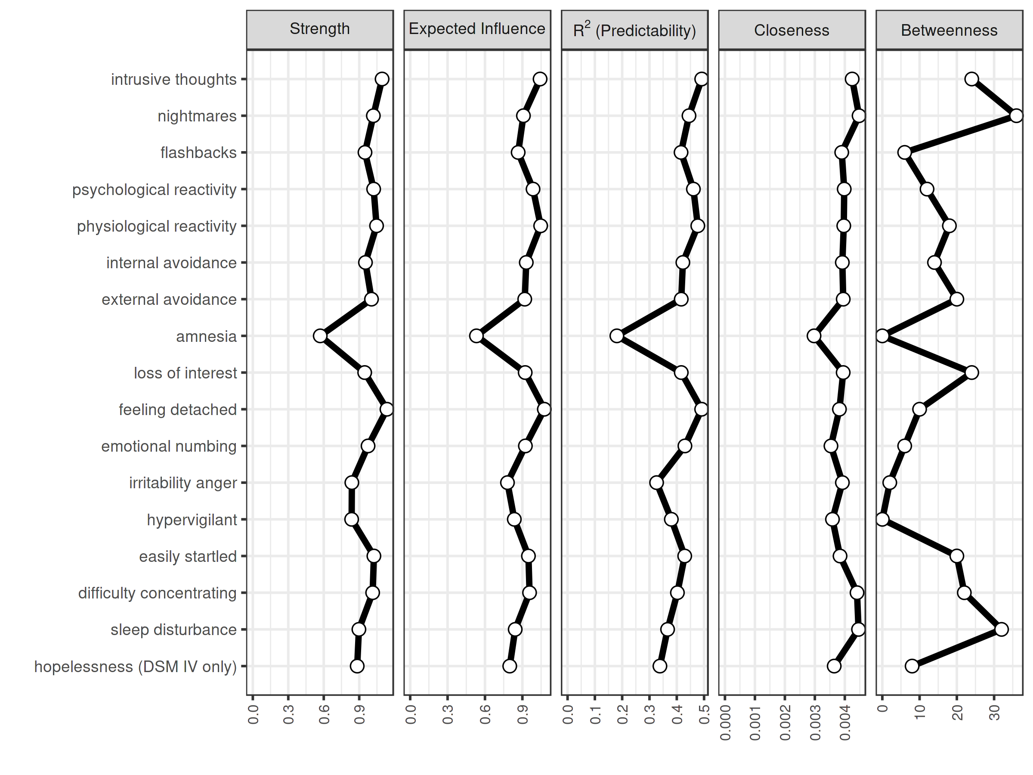
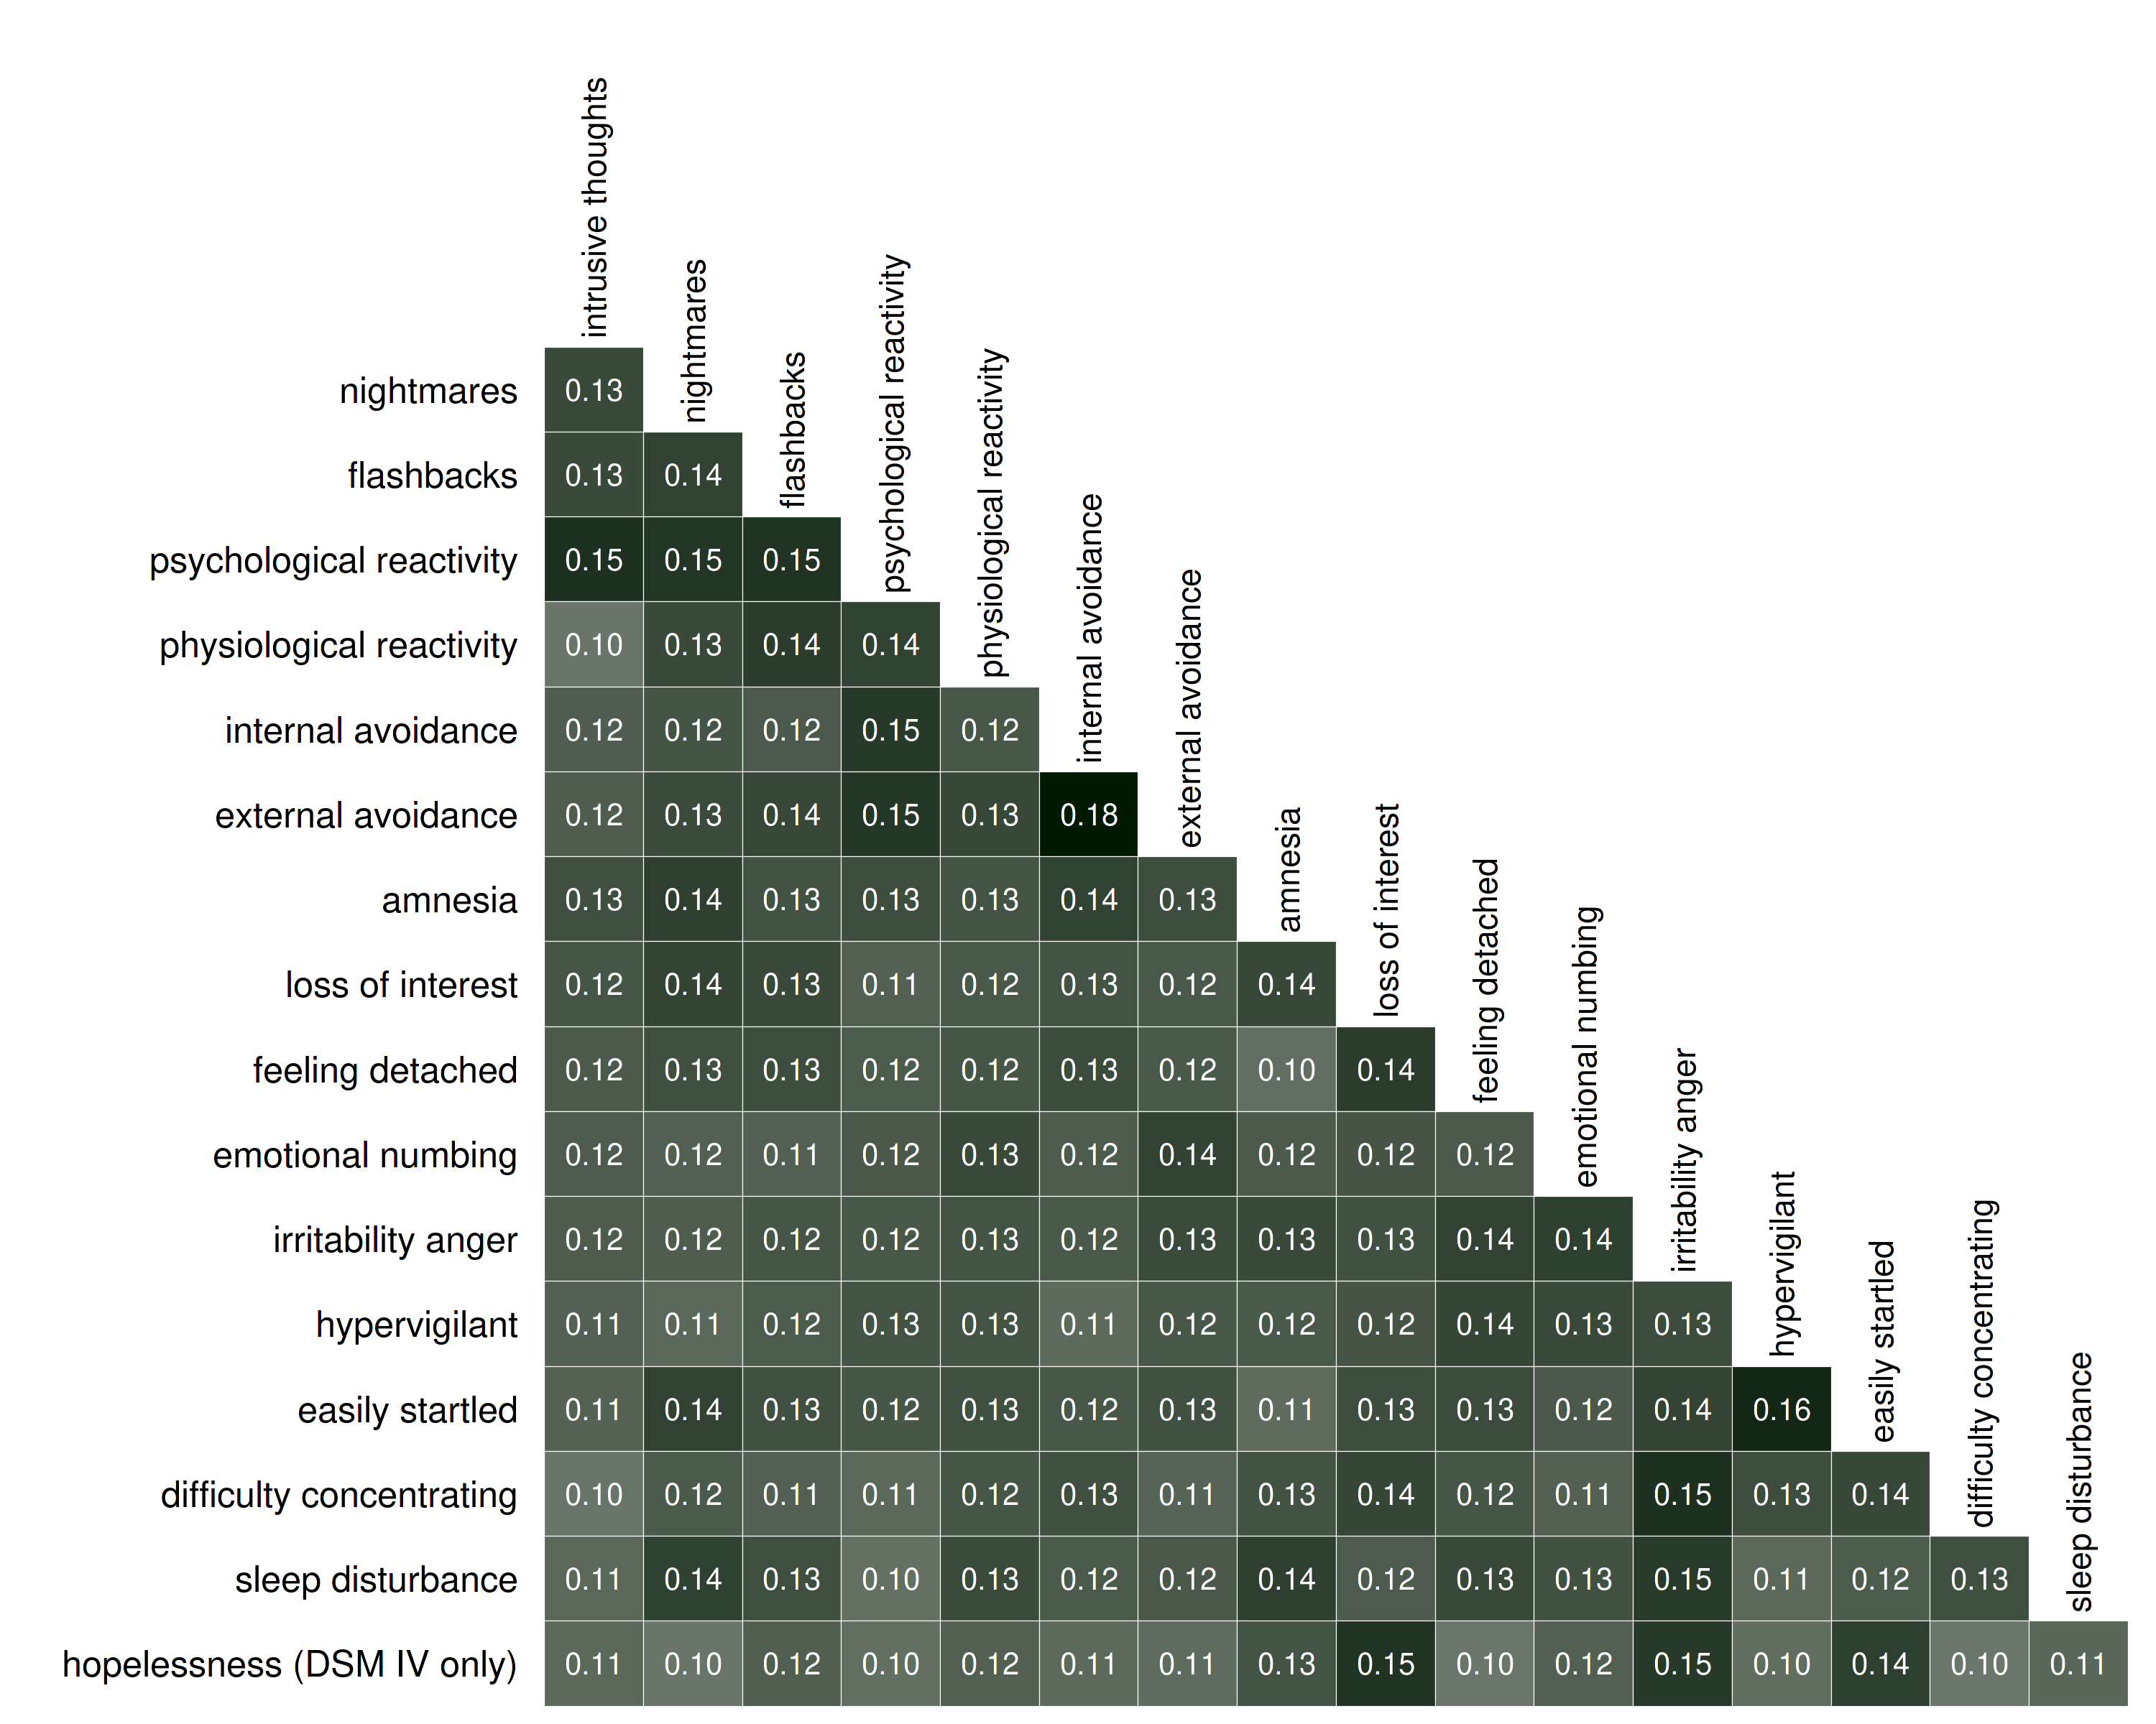
Cross-study heterogeneity on implied correlations
Centrality indices
Sacha Epskamp
www.sachaepskamp.com

Slide 34

From Exploration to Theory Formation
Sacha Epskamp
www.sachaepskamp.com

Slide 35





Sacha Epskamp
www.sachaepskamp.com

Slide 36


Negative Emotionality (Anxiety):
$$\frac{dNE}{dt}=\left(\left(A∗Str.\right)−B−\left(C−D∗Tol.\right)∗Av.\right)∗NE∗\left(1−NE\right)$$
Regulation (Benzodiazepine):
$$\frac{dAv.}{dt}=\left(E∗NE−G∗Av.\right)∗Av.∗(1−Av.)$$
Tolerance:
$$\frac{dTol.}{dt}=(H∗Av.∗\left(1−Tol.\right)−I∗Tol.)/7$$
Stressor:
$\frac{dStr.}{dt}=(J∗Av.∗\left(1−Str.\right)−K∗Str.)$/7
Anxiety
Stressor
Tolerance
Benzo-diazepine
Burger, J., van der Veen, D. C., Robinaugh, D. J., Quax, R., Riese, H., Schoevers, R. A., & Epskamp, S. (2020). Bridging the gap between complexity science and clinical practice by formalizing idiographic theories: a computational model of functional analysis. BMC medicine, 18(1):99.
Sacha Epskamp
www.sachaepskamp.com

Slide 37
Anxiety
Anxiety
Benzodiazepine
Stressor
Tolerance
Tolerance
Stressor
Benzo-diazepine
Burger, J., van der Veen, D. C., Robinaugh, D. J., Quax, R., Riese, H., Schoevers, R. A., & Epskamp, S. (2020). Bridging the gap between complexity science and clinical practice by formalizing idiographic theories: a computational model of functional analysis. BMC medicine, 18(1):99.
Sacha Epskamp
www.sachaepskamp.com

Slide 38
Anxiety
Anxiety
Benzodiazepine
Stressor
Tolerance
Tolerance
Stressor
Benzo-diazepine
Burger, J., van der Veen, D. C., Robinaugh, D. J., Quax, R., Riese, H., Schoevers, R. A., & Epskamp, S. (2020). Bridging the gap between complexity science and clinical practice by formalizing idiographic theories: a computational model of functional analysis. BMC medicine, 18(1):99.
Sacha Epskamp
www.sachaepskamp.com

Slide 39
Anxiety
Anxiety
Benzodiazepine
Stressor
Tolerance
Tolerance
Stressor
Benzo-diazepine
Burger, J., van der Veen, D. C., Robinaugh, D. J., Quax, R., Riese, H., Schoevers, R. A., & Epskamp, S. (2020). Bridging the gap between complexity science and clinical practice by formalizing idiographic theories: a computational model of functional analysis. BMC medicine, 18(1):99.
Sacha Epskamp
www.sachaepskamp.com

Slide 40
Anxiety
Anxiety
Benzodiazepine
Stressor
Tolerance
Tolerance
Stressor
Benzo-diazepine
Burger, J., van der Veen, D. C., Robinaugh, D. J., Quax, R., Riese, H., Schoevers, R. A., & Epskamp, S. (2020). Bridging the gap between complexity science and clinical practice by formalizing idiographic theories: a computational model of functional analysis. BMC medicine, 18(1):99.
Sacha Epskamp
www.sachaepskamp.com

Slide 41
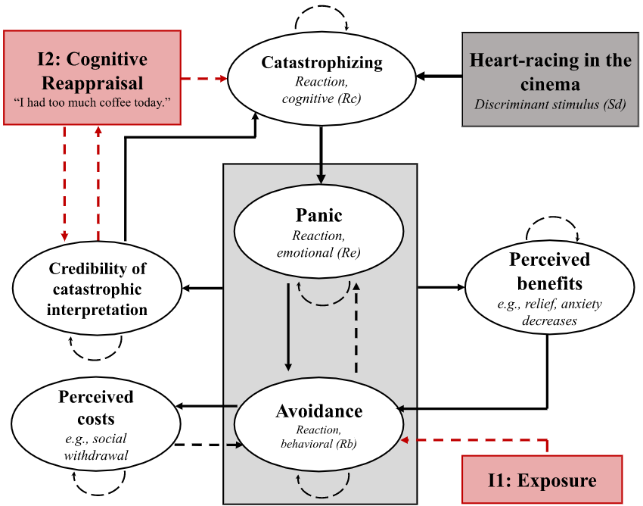
Burger, J., van der Veen, D. C., Robinaugh, D. J., Quax, R., Riese, H., Schoevers, R. A., & Epskamp, S. (2020). Bridging the gap between complexity science and clinical practice by formalizing idiographic theories: a computational model of functional analysis. BMC medicine, 18(1):99.
Sacha Epskamp
www.sachaepskamp.com

Slide 42
Burger, J., van der Veen, D. C., Robinaugh, D. J., Quax, R., Riese, H., Schoevers, R. A., & Epskamp, S. (2020). Bridging the gap between complexity science and clinical practice by formalizing idiographic theories: a computational model of functional analysis. BMC medicine, 18(1):99.
Sacha Epskamp
www.sachaepskamp.com

Slide 43

Conclusion
The Network Perspective of Psychology aims to conceptualize psychological concepts as emergent behavior in a complex system.
The field of Network Psychometrics focusses on estimating network models from (cross-sectional / longitudinal) data.
This grew popular in recent years in, especially in clinical psychology and psychiatry (e.g., PTSD / Schizophrenia / Depression / Clinical practice).
We conducted the first meta-analysis of PTSD symptom network structures.
Rather than obtaining a model through data exploration, a model can also be formed through theory.
Sacha Epskamp
www.sachaepskamp.com

Slide 44

Thank you for your attention!
Sacha Epskamp – NUS Seminar 05/02/2020
Sacha Epskamp
www.sachaepskamp.com

