Slide 1
Reproducibility and Replicability in a Fast-paced Methodological World
Sacha Epskamp

Slide 2
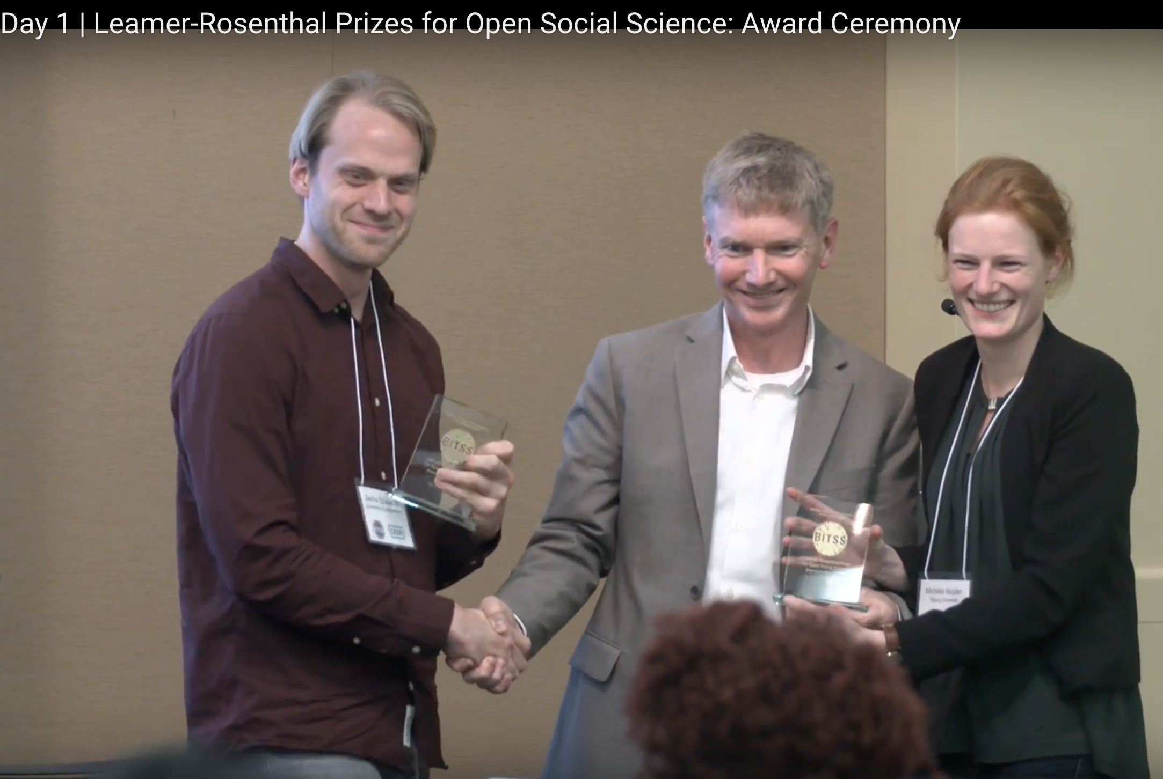
A long time ago…
Developed together with Michele Nuijten in 2011-2012, after which I moved on to…

Slide 3
Network Psychometrics
http://sachaepskamp.com/Dissertation

Slide 4
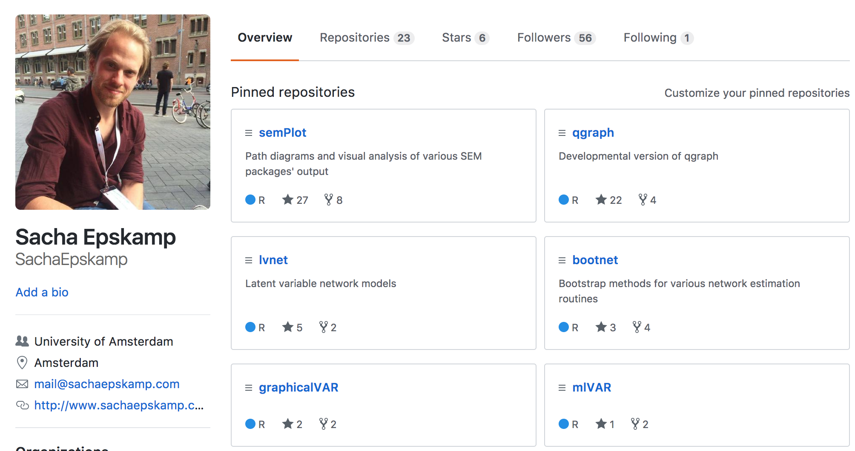

Slide 5
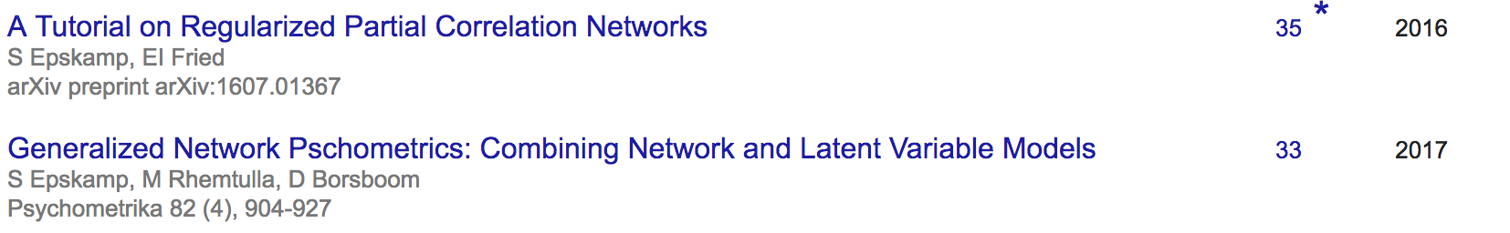

Slide 6
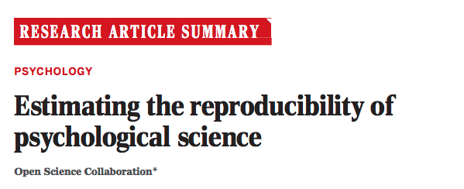
Reproducibility and Replicability
Reproducibility
  Using the same data obtaining the same results
  Basic requirement for replicability:
Replicability
  Obtaining similar results in new data
  If results are not reproducible, we cannot expect them to be replicable

Slide 7
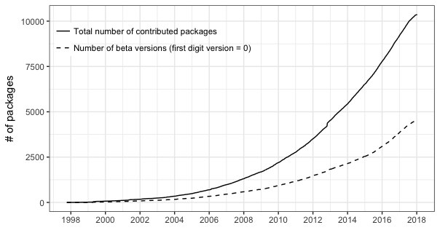
Fast-paced Methodological World
Rapidly growing number of statistical software packages

Slide 8


Fast-paced Methodological World
Rapidly growing number of methodological pre-prints

Slide 9
Goal
While the age of fast-paced methodology greatly facilitates reproducibility, it also undermines it in ways not often realized by researchers. I will discuss:
Sources of Limited Reproducibility and Replicability in Novel Methodology
Sources of Limited Reproducibility and Replicability in Software
Recommendations for improving reproducibility
  Methodologists
  Empirical Researchers

Slide 10
Sources of Limited Reproducibility and Replicability in Novel Methodology

Slide 11
Researcher Degrees of Freedom
Usually many choices made in performing some analysis
  Prior in Bayes Factors
  Standardization
  …
May impact replicability
  Results may only replicate using very specific design choices
  Results may not replicate using future state-of-the-art
Multiverse analysis remediates the first, but not the second
  And may be complicated…

Slide 12
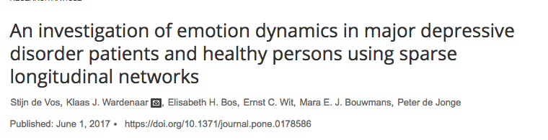
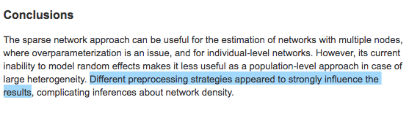

Slide 13
Lack of Validation Studies
Novel methods may be only validated in certain settings, or proven under certain conditions
  Multivariate normality
  Sparsity
Such conditions may be violated in empirical datasets
  Not clear how well method performs
  Results may not replicate using future state-of-the-art

Slide 14
Pre-print Reports
It used to take a long time before methodological papers were made public…
 | Quantile
 | 0% | 25% | 50% | 75% | 100%
Review time | 0 | 287 | 408 | 542 | 4310
Online lag | 38 | 90 | 121 | 165 | 551
Print lag | 53 | 148 | 218 | 291 | 874
Total time | 55 | 428 | 570 | 706 | 4392
Time in days for the journal Psychological Methods
Source: http://persistentastonishment.blogspot.nl/2015/07/median-publication-delays-at-38-apa.html

Slide 15
Pre-print Reports
Now, methodological reports can be made public instantly using pre-print reports
These reports may not have been checked by external experts
The pre-print report may contain errors, or may change severely throughout the review process
  That is the whole purpose of peer-review to begin with!
Empirical work based on earlier versions of the pre-print may find their analyses now outdated or their conclusions now no longer warranted

Slide 16
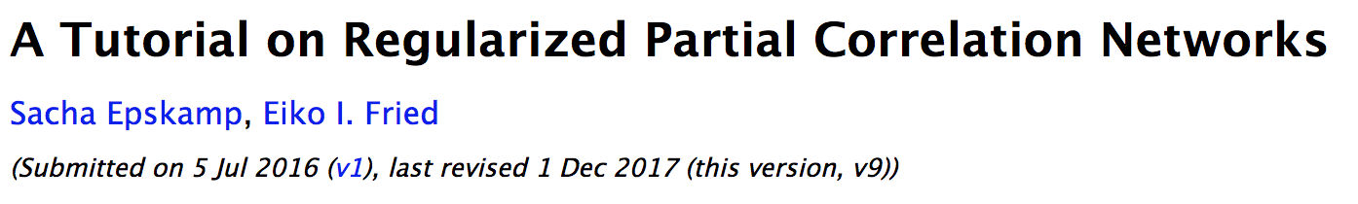
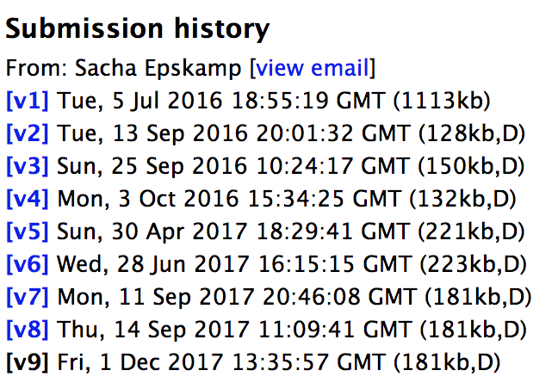

Slide 17
Sources of Limited Reproducibility and Replicability in Software

Slide 18
Beta Versions
Developers typically indicate software is still unstable / in development by denoting the version number as 0 (beta version)
Using such software comes at a risk

Slide 20
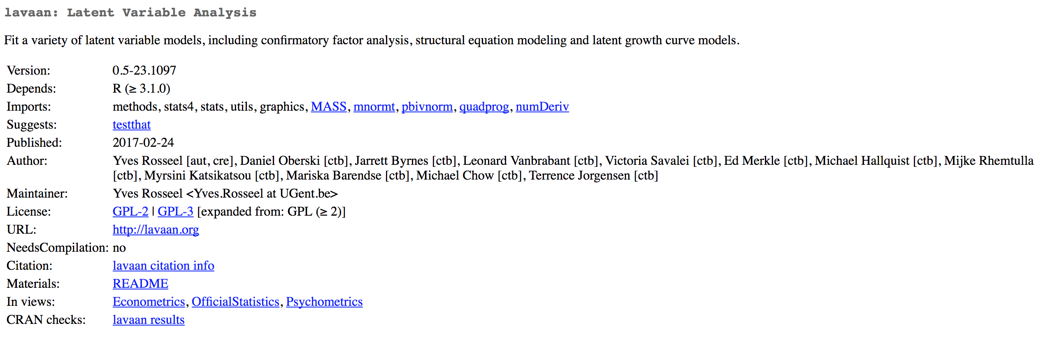
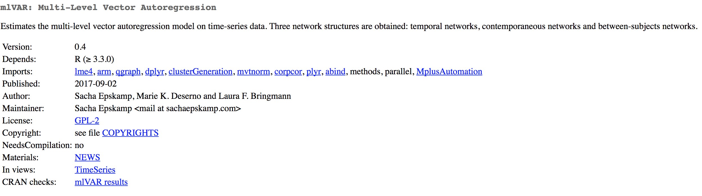

Slide 21
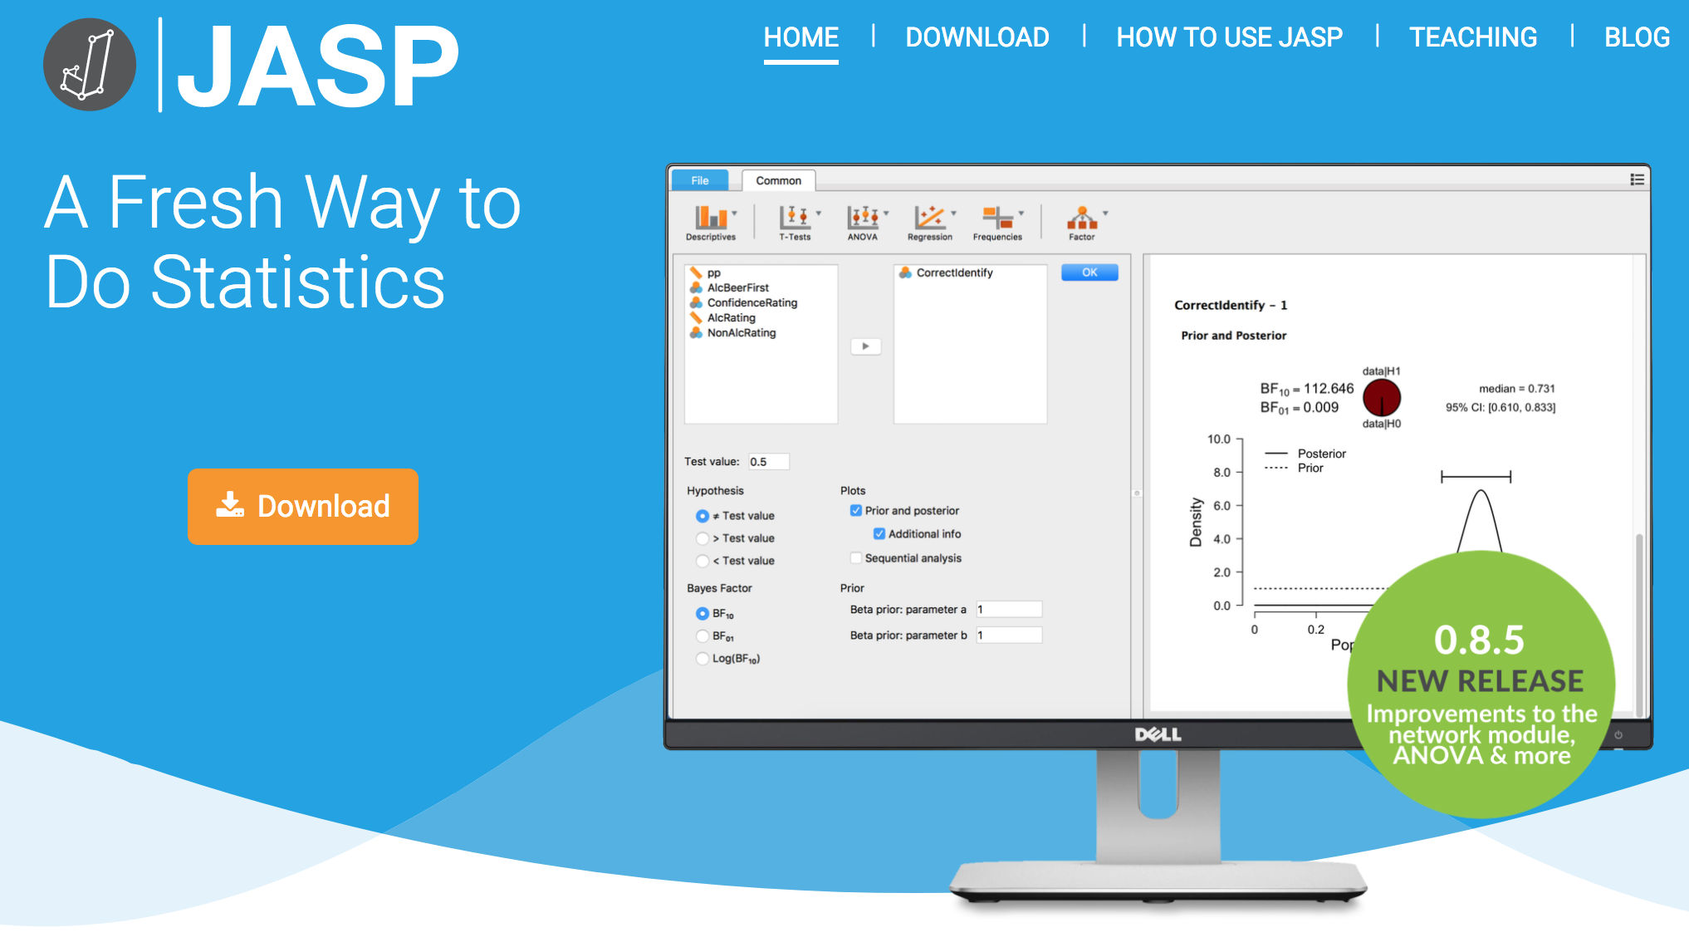

Slide 22
Are beta versions bad?
No, it simply indicates the developers do not yet deem the software stable enough to warrant a release version
Input, output, argument names, default options etcetera may still change
  This may lead to reproducibility problems!
There may be bugs
  But then again, every program has bugs
At least report the version number! A 0 implies beta software
Note that especially open-source developers sometimes *never* set the version number > 0

Slide 23
Bugs and Unexpected Results
Typically, methodologists are not trained in software engineering
As a result, methodological software may not be optimally coded or thoroughly checked
Using unexpected input may lead to unexpected output, and there may be bugs
Methodological software may also not be well maintained, leading to new bugs to be introduced in the future
  Many R packages only maintained by one person, who may change jobs or have other duties

Slide 24
Updates and Changes
Even crystalized software may change
  Defaults may change due to user feedback
  Methodological advances may warrant updates to estimation algorithms
  Bugs may be fixed
This leads to a risk that codes will not reproduce using later versions of the software
Unfortunately, especially R has virtually no backward compatibility!

Slide 25
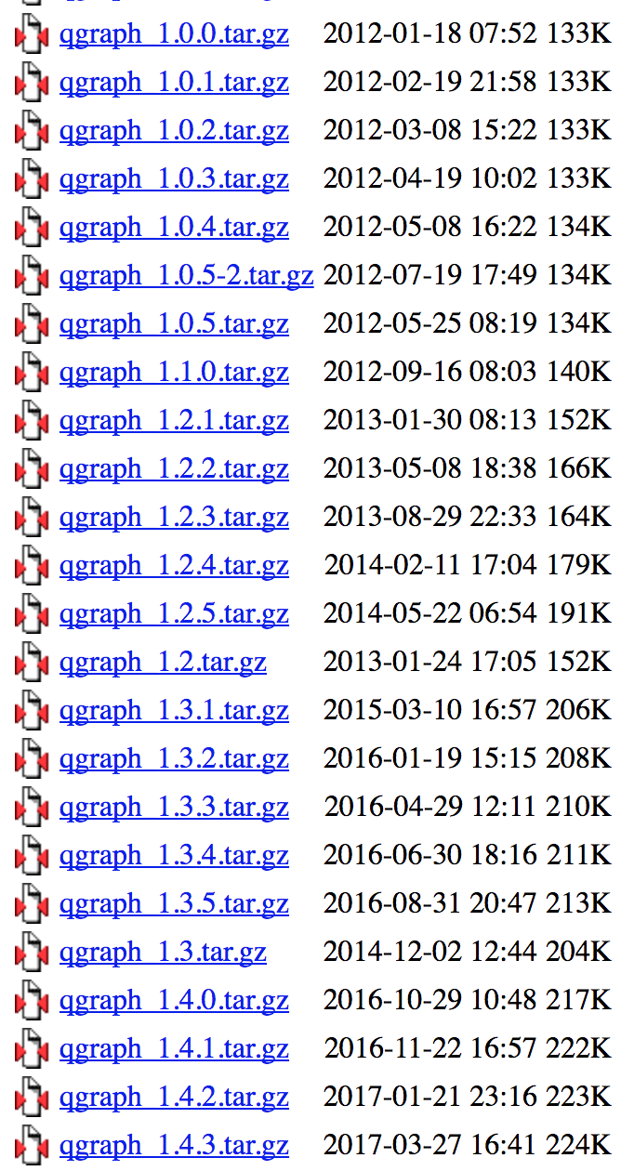
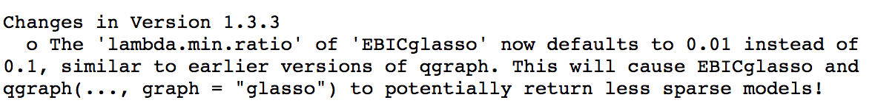

Slide 28
Dependencies
All problems mentioned are greatly inflated by huge dependency trees between software packages
Codes may not reproduce because one package changed, or because any of the depended packages changed
Virtually impossible to trace back the source of the problem
Changes in depending packages may also introduce new bugs!

Slide 29
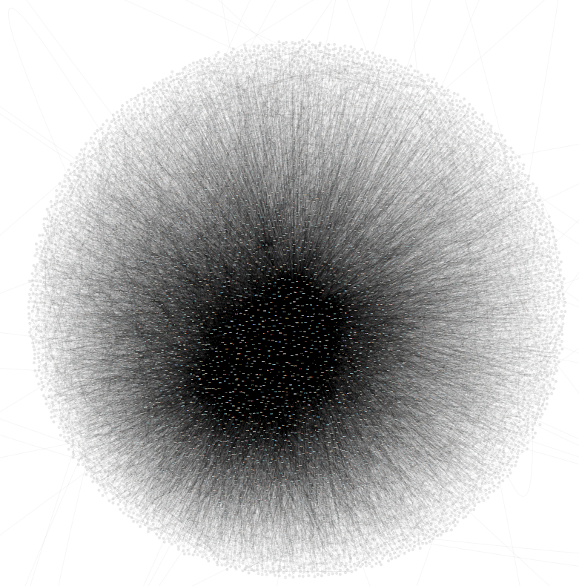
Full CRAN dependency network

Slide 30
Bootnet dependency network

Slide 31
Recommendations for Improving Reproducibility

Slide 32

Distribute codes together with methodological publications

Slide 33
Distribute codes together with methodological publications
Methodological studies without supplemented codes are hardly not reproducible
  Especially not by empirical researchers
If results do not reproduce, without codes you don’t know if that is due to:
  Problems with the method itself
  Inconsistencies in implementation of the method
If you ran a simulation study, you have codes!
The more flexible your codes, the better
  Do not hard-code variable names, sample size, etcetera

Slide 34
Provide documentation to the codes
Codes are useless if nobody understands how to use them
In a script: Add comments indicating what codes do and where users can change something
In a function: Provide a description of expected input and the output
For codes written in R, an ideal format in presenting codes is the form of an R package to be submitted to the Comprehensive R Archive Network (CRAN)
  Requires you to pass numerous checks designed to force you to provide basic documentation

Slide 35
Use a clear coding style
If your codes are not readable, then others cannot figure out what you did
Thus, unreadable codes are almost not reproducible by others in different programming languages
Some tips to make your code better:
  Use a style guide
    E.g., https://google.github.io/styleguide/Rguide.xml
  Use many clarifying comments
  Use informative object names
  Use spaces / indents!

Slide 36
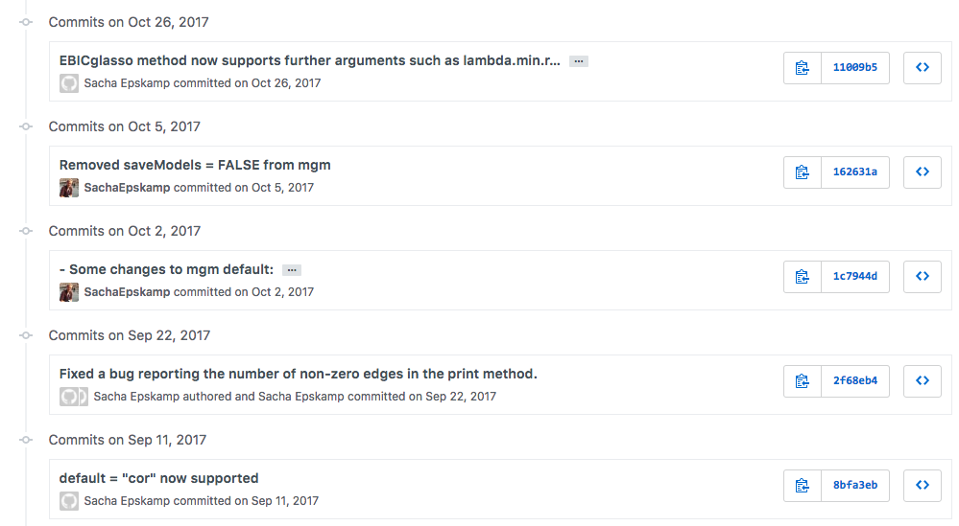
Use a version-control system

Slide 37
Use a version-control system
Github is a great online repository!
  Integrated with git
  Clearly shows when what changes are made
  Allows users to report bugs / ask questions
  Allows others to suggest code changes
    Pull requests

Slide 38
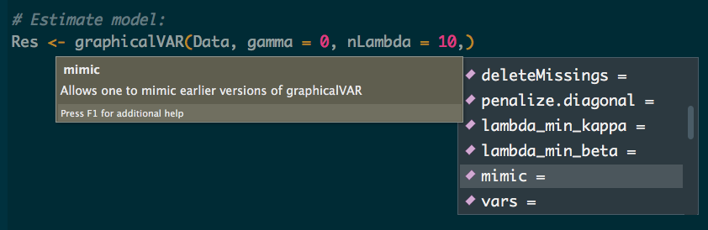
Offer backward compatibility
When software defaults change, you want to make it possible to reproduce earlier analyses
At least include arguments that can be set to mimic the earlier version
Another option is to add a “mimic” argument that you can assign a version number
Note: if the outcome change is due to a depending package changing, there is not much you can do…

Slide 39
Recommendations for Empirical Researchers
Understand the methodology
  If you do not understand the methodology, you do not know when something goes wrong
  Your results may not replicate, simply because they rely on errors
The more crystallized the software, the more likely codes will reproduce
  Crystalized software is less likely to change and more likely to be validated
  Note: many software packages may not be regarded as fully crystalized!

Slide 40
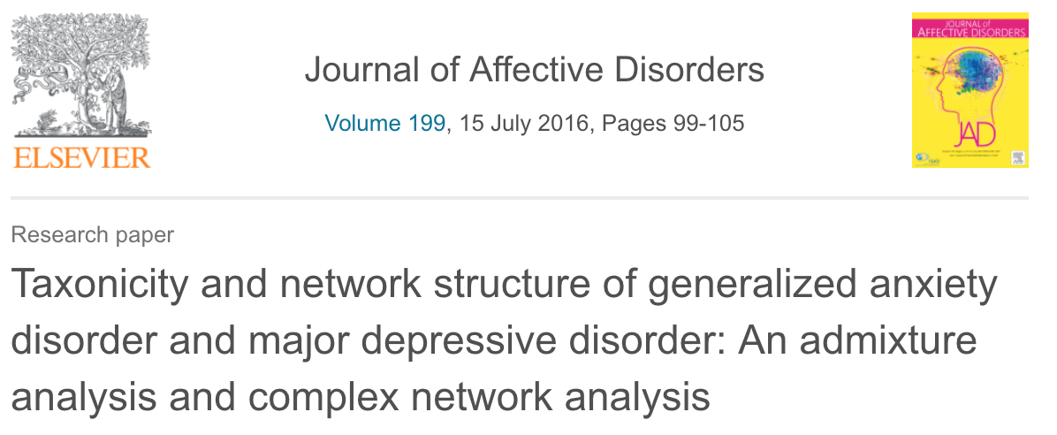
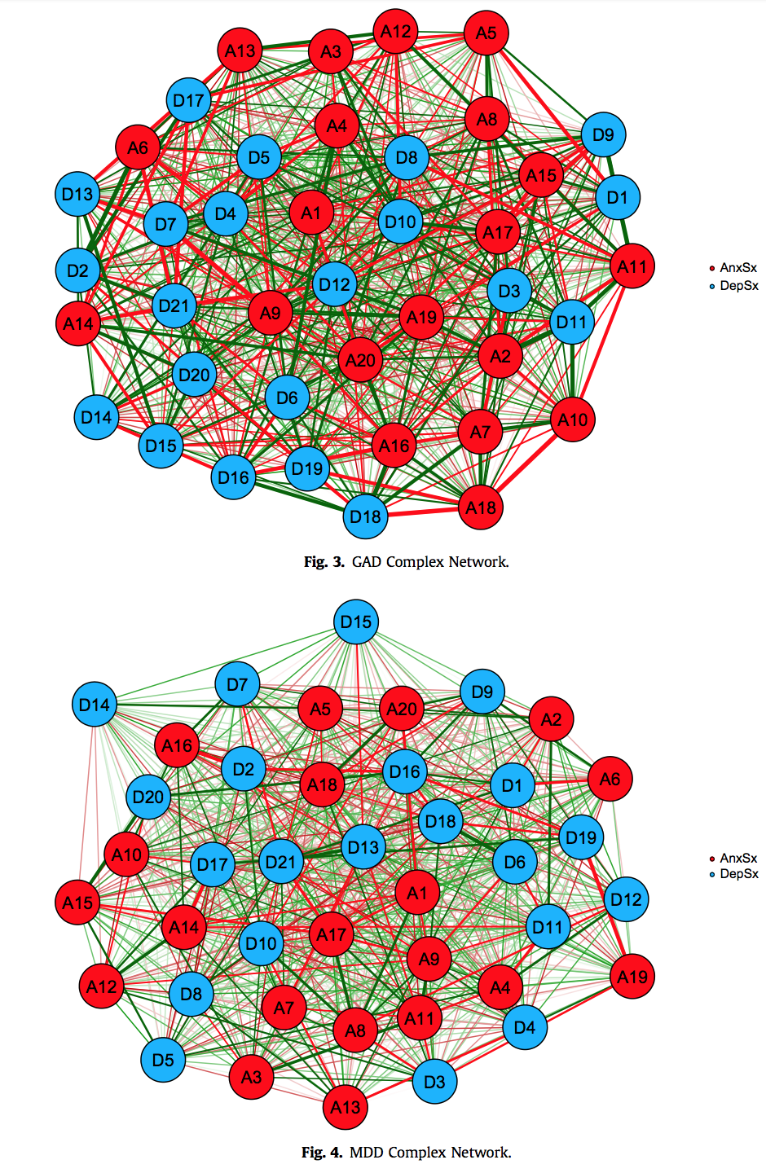
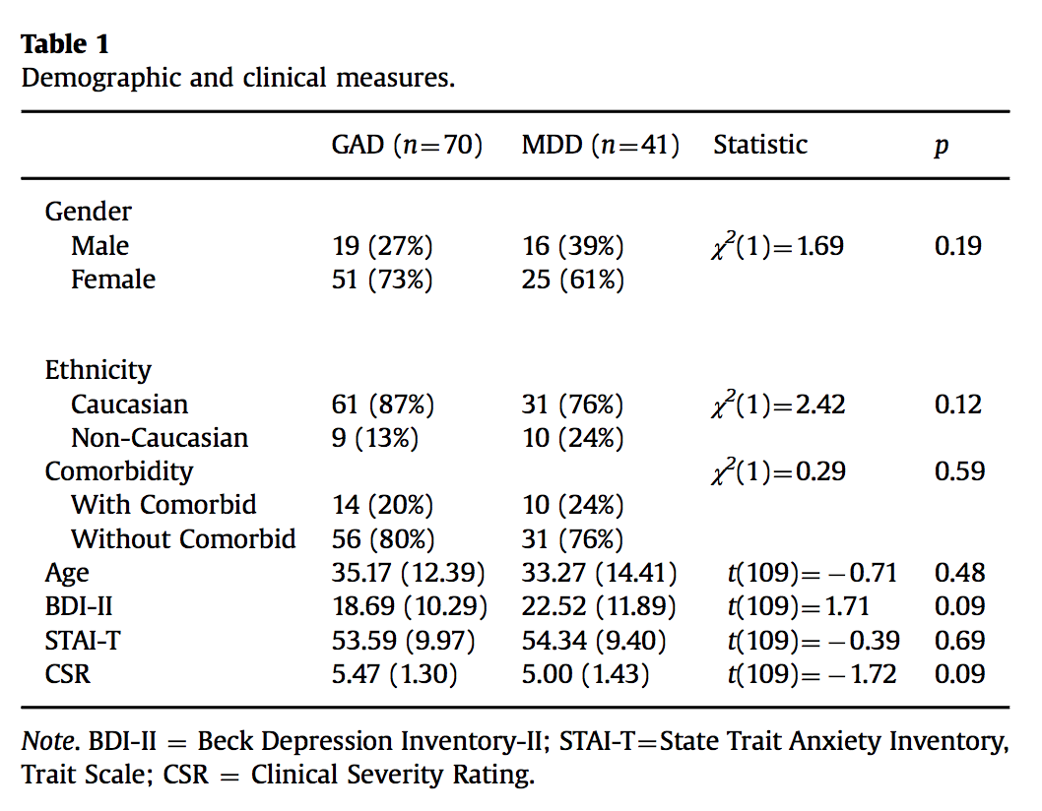

Slide 41
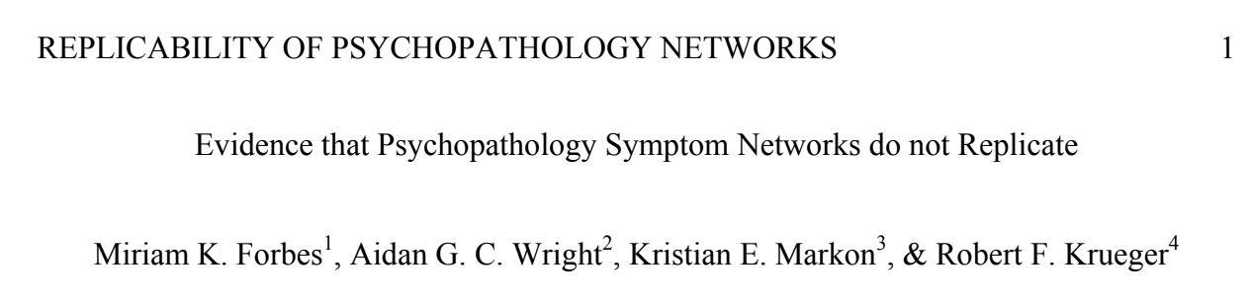

Slide 42
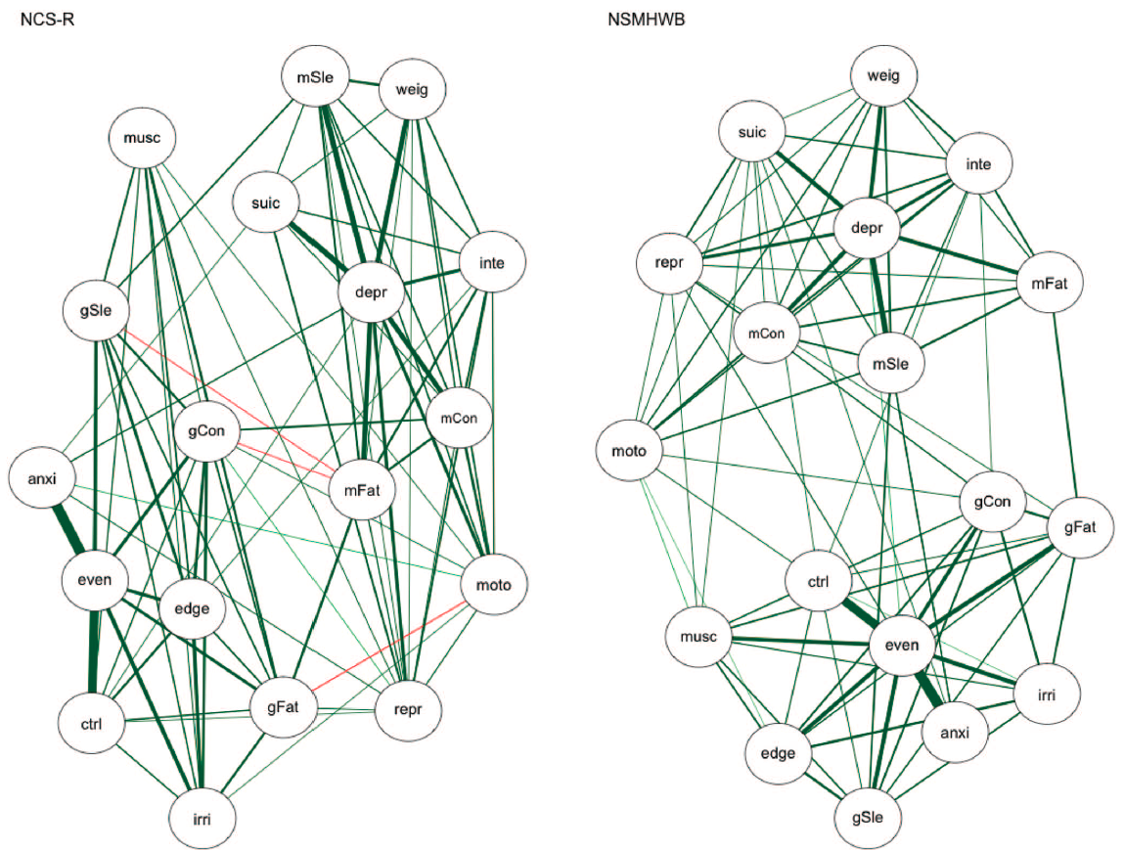
Ising Models

Slide 43
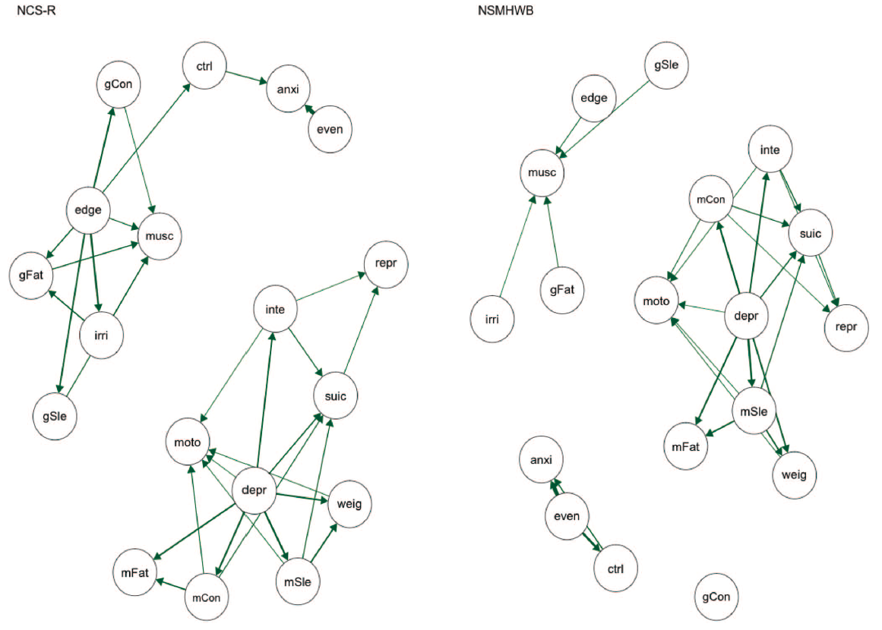
“Relative importance networks”

Slide 44
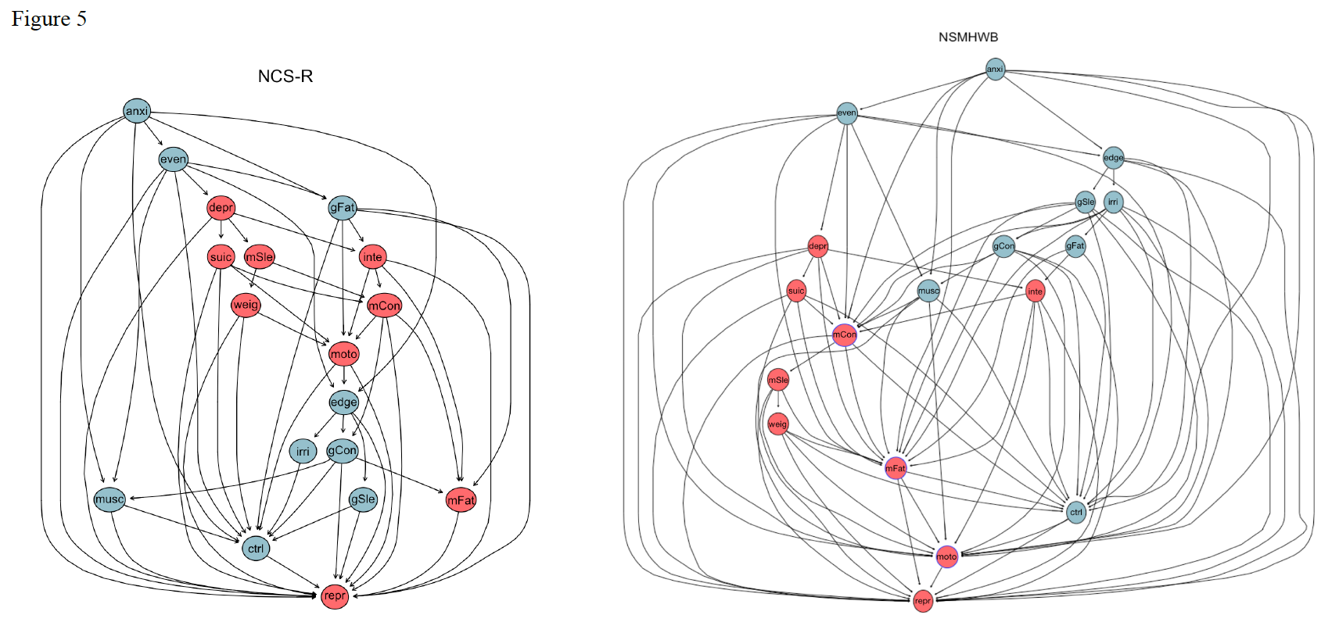
“Directed Acyclic Graphs”

Slide 45
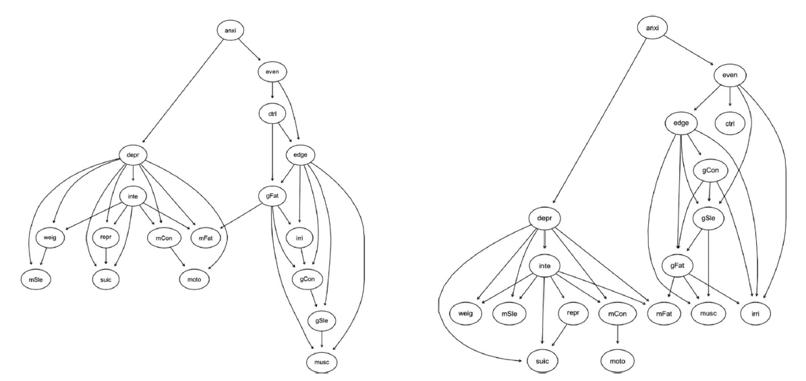
Directed Acyclic Graphs
Changed after acceptance and without new peer-review

Slide 46
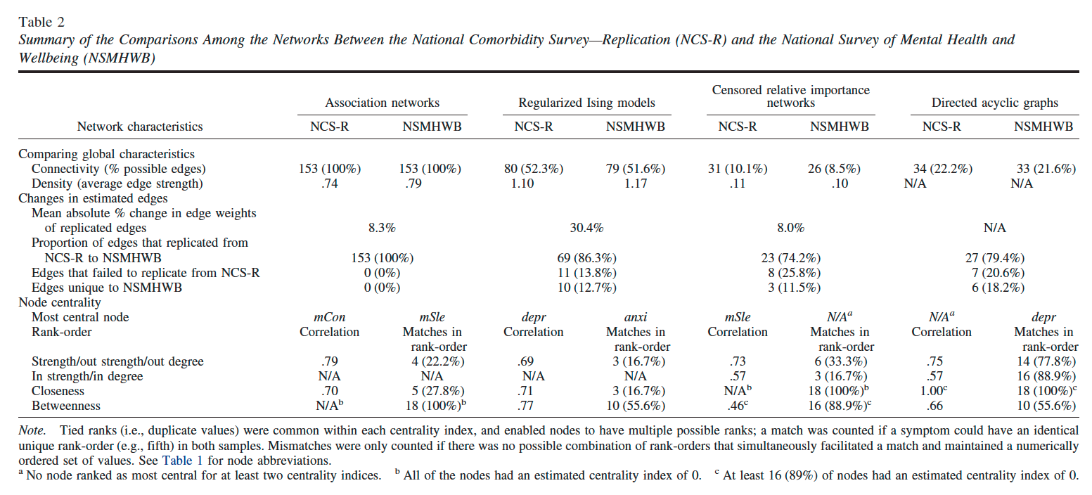
Forbes et al. results

Slide 47
Our re-analysis

Slide 48
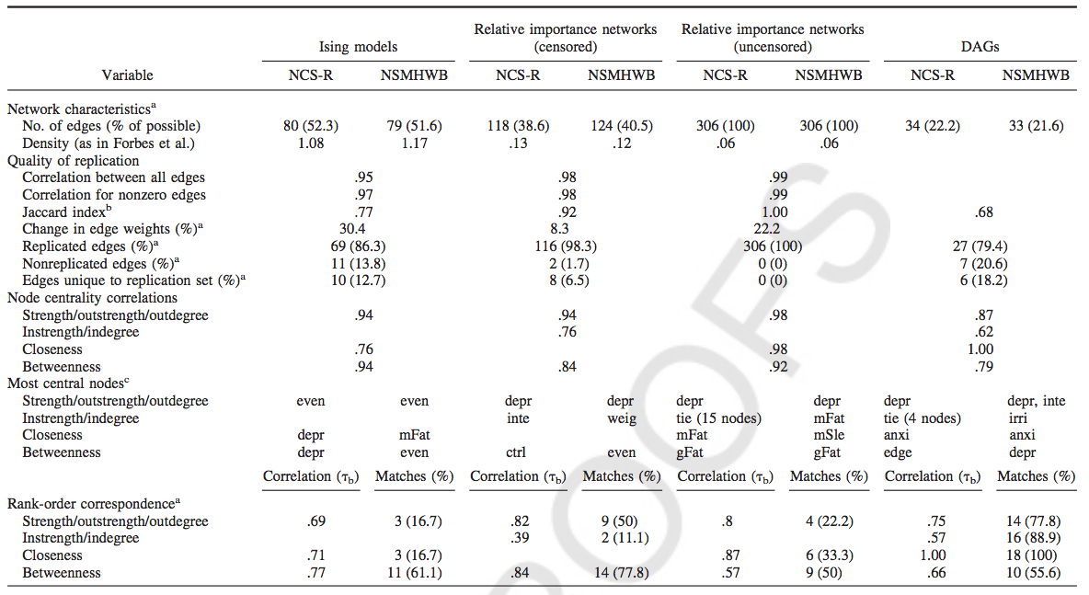
Our re-analysis

Slide 49
Crystalized-software checklist
The software is not in beta version
The software is validated in a methodological study
The software is well documented and/or accompanied by tutorials
The source codes are openly available
Note: very few software routines will pass all these checks! Not all are required; the more the better!

Slide 50
Summary
While the age of fast-paced methodology greatly facilitates reproducibility, it also undermines it in ways not often realized by researchers. I will discuss:
Sources of Limited Reproducibility and Replicability in Novel Methodology
Sources of Limited Reproducibility and Replicability in Software
Recommendations for improving reproducibility
  Methodologists
  Empirical Researchers

Slide 51
Thank you for your attention!

