Slide 1
Network-Based Adaptive Assessment
Sacha Epskamp

Slide 2
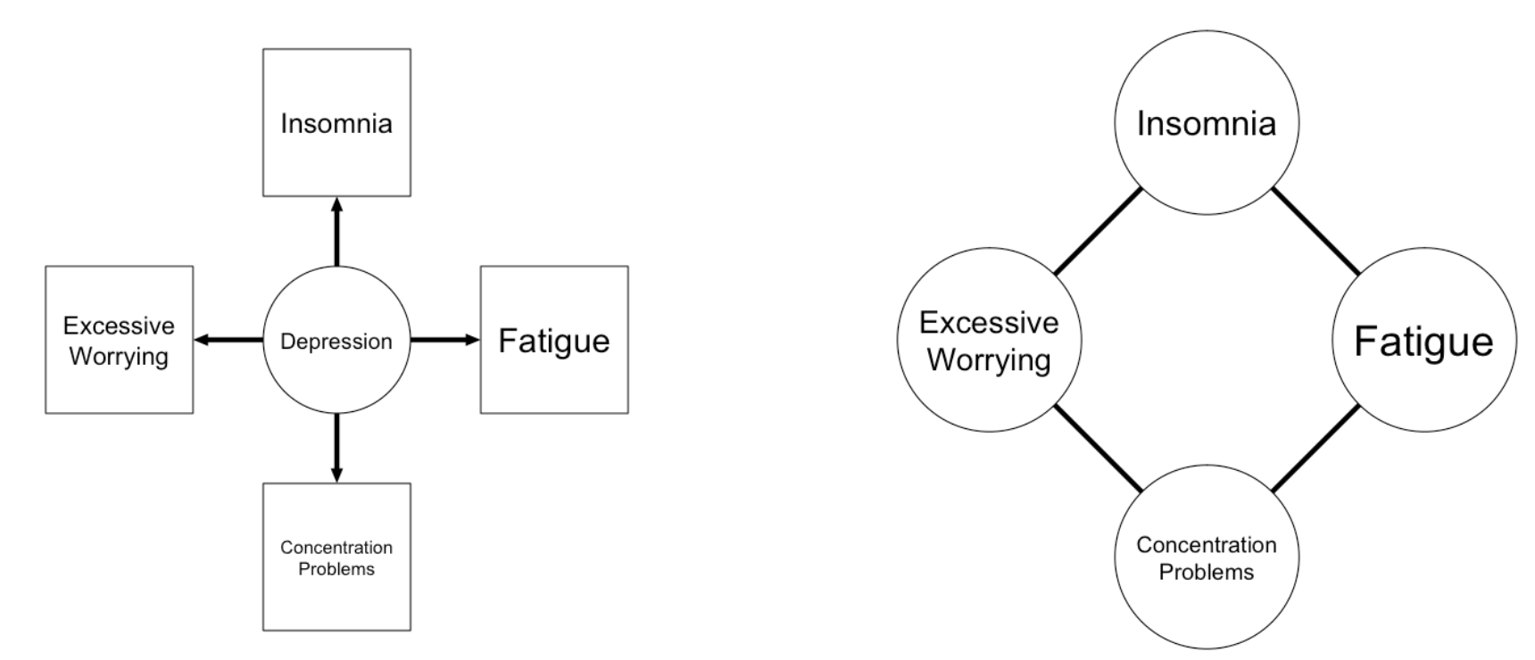
Tests from a Network Perspective
Interest in the score pattern rather than latent traits
  Symptom diagnosis rather than disorder diagnosis
  Voting recommendation based on specific opinions, rather than conservatism / left-right
  Matchmaking on matching people with similar interests, rather than on traits
But… too many questions to ask!
Computer adaptive testing (CAT) relies often on latent variables
  Use networks instead?

Slide 3
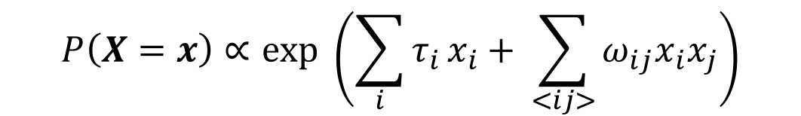
Network Models
Suppose variables take states -1 and 1
The Ising model characterizes a joint likelihood distribution given only observed variables
This can (in principle) be used to obtain marginal probabilities, conditional probabilities, (conditional) entropy
Also very easy to sample from!
  Metropolis-Hastings
$$P\left(X=x\right)∝exp \left(\sum_{i}{τ_{i }x_{i}}+ \sum_{<ij>}{ω_{ij}x_{i}x_{j}}\right)$$

Slide 4
Weights <- matrix(c(
0, 0.5, 0,
0.5, 0, -0.5,
0, -0.5, 0) ,3,3,byrow=TRUE)
Thresholds <- c(-0.5,0,-0.5)
library("IsingSampler")
IsingLikelihood(Weights, Thresholds, beta = 1, responses = c(-1, 1))
Probability Var1 Var2 Var3 0.22019927 -1 -1 -1 0.02980073 1 -1 -1 0.22019927 -1 1 -1 0.22019927 1 1 -1 0.22019927 -1 -1 1 0.02980073 1 -1 1 0.02980073 -1 1 1 0.02980073 1 1 1

Slide 5

Are you tired?
yes no
Are you tired?
yes
Do you sleep well?
yes no
Tired
= yes

Slide 6
Are you tired?
yes no
Are you tired?
no
Are you tense?
yes no
Tired
= no

Slide 7
Network-based adaptive assessment
Estimate an Ising model from available data
  E.g., using IsingFit by Claudia van Borkulo
Compute for each unknown item the conditional entropy given that item
Administer the item that gives the lowest conditional entropy
Go to 2, or stop based on some criterion
Problem: intractable normalizing constant and likelihood table

Slide 8
Workaround…
Estimate an Ising model from available data
  E.g., using IsingFit by Claudia van Borkulo
Generate a large database (e.g., 100,000)
  E.g., using IsingSampler
Compute for each unknown item the empirical conditional entropy given that item, using the database
Administer the item that gives the lowest empirical conditional entropy
Subset the database to only include cases in line with known responses
If the number of cases in the database drops below some number (e.g., 500), generate a new database (e.g., 5,000)
Go to 3, or stop based on some criterion

Slide 9
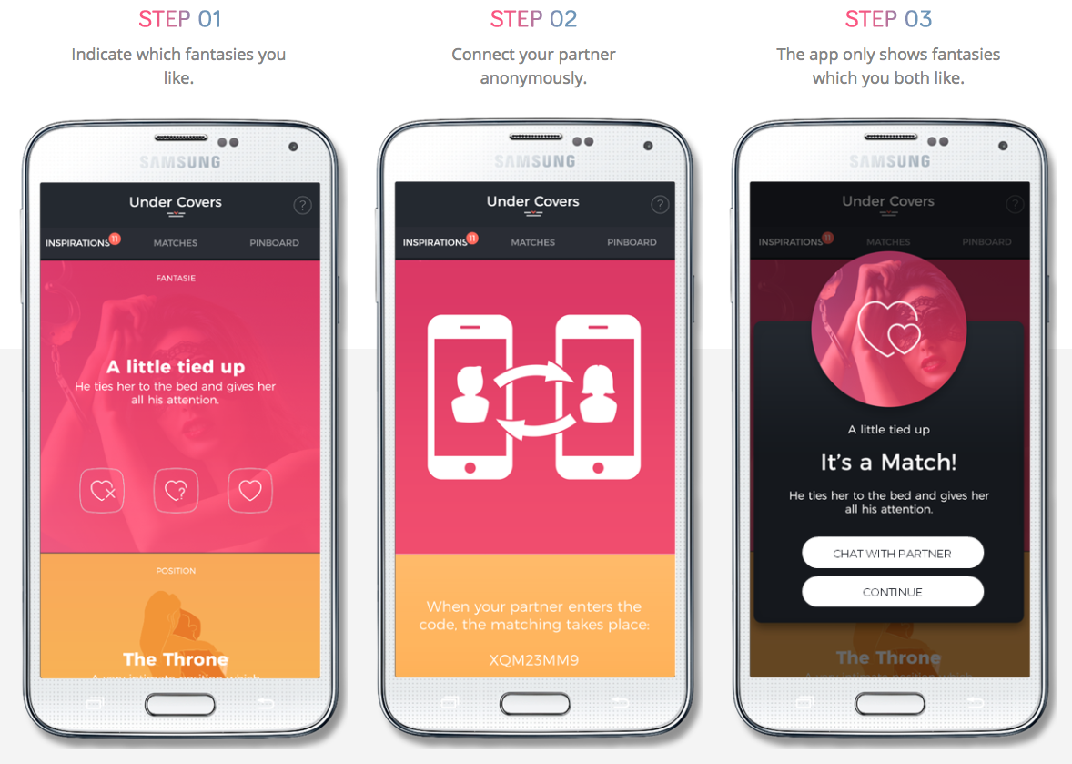
Data & app: https://undercoversapp.com/
Thanks to: Theresa Wallner & Sophia von Stockert

Slide 14
...

Slide 16
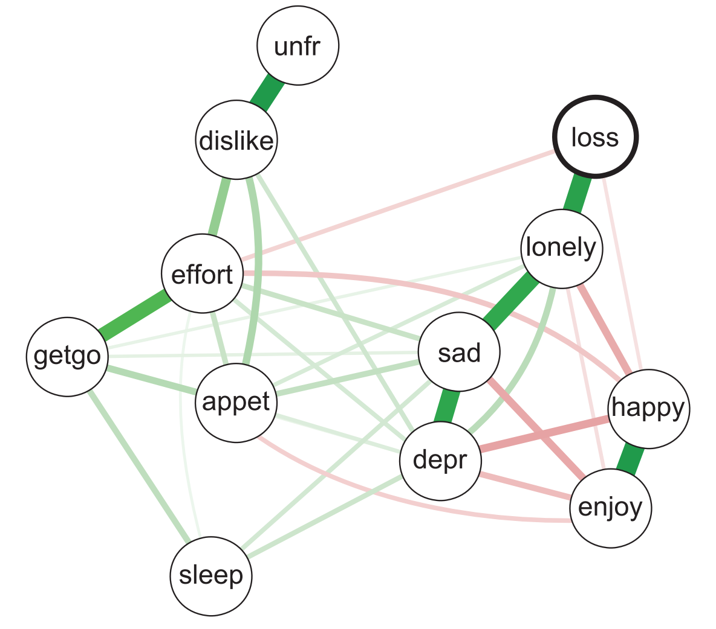
Simulation Study 1
Empirical Ising model used as true structure
  Fried, E. I., Bockting, C., Arjadi, R., Borsboom, D., Tuerlinckx, F., Cramer, A., Epskamp, S., Amshoff, M., Carr, D., & Stroebe, M. (2015). From loss to loneliness: The relationship between bereavement and depressive symptoms. Journal of Abnormal Psychology, 124, 256-265.
Generate 1 case from true model
Simulate adaptive assessment, using the true model, or IRT model based on N = 100,000 databank
Each condition replicated 100 times

Slide 19
Simulation Study 2
Full data of 99 items from UnderCovers (N = 5,998)
500 cases used in test-set, rest of cases used in training-set
Ising/IRT models estimated from training set
Take 1 case from test-set
Simulate adaptive assessment
Each condition replicated 100 times

Slide 25
Conclusion & Future directions
New aim: predict all responses based on given responses
Network models capable of doing this
  Also: temporal networks capable of predicting responses at later time points
To do:
  Compare to multivariate CAT methods
  Fasten item-selection process
  Work out methods for item-selection without sampling data
  Continuous / ordinal data networks
Grant proposal: Implement in fully adaptive environment
  Update network as new data comes in
  Adaptive assessment in time-series data

Slide 26
Thank you for your attention!

Slide 27
Extra slides…

Slide 28


Computerized Adaptive Testing (CAT)

Slide 29
Data
Exploratory insight (B/W)
Hypothesis generation (B/W)
Treatment formation (B/W)
Likelihood estimation (B/W)
Applications
Network Estimation
Adaptive Assessment
Score Prediction
Applications
Applications
Test reduction (B/W)
Patient Monitoring (W)
Data gathering
Diagnosis (B)
Prediction (W)
Matching (B)
B: Between-subjects
W: Within-subjects

Slide 30
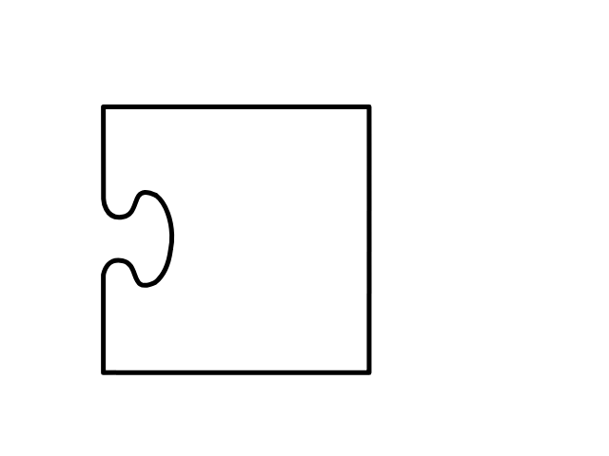
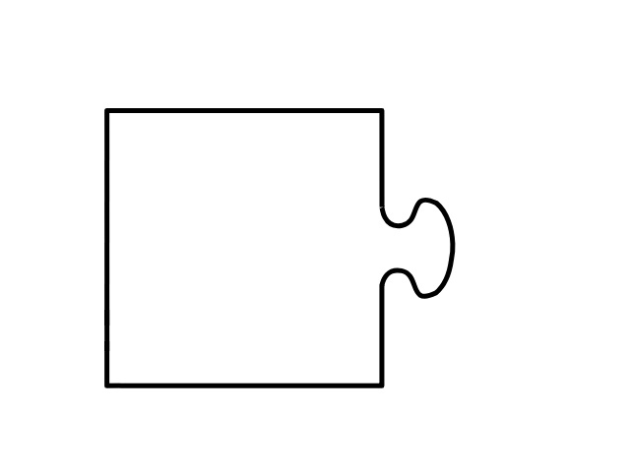
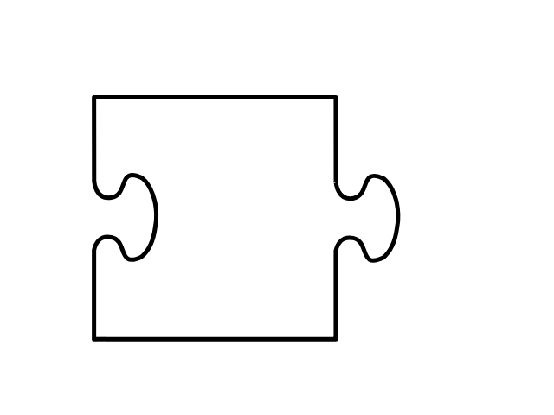

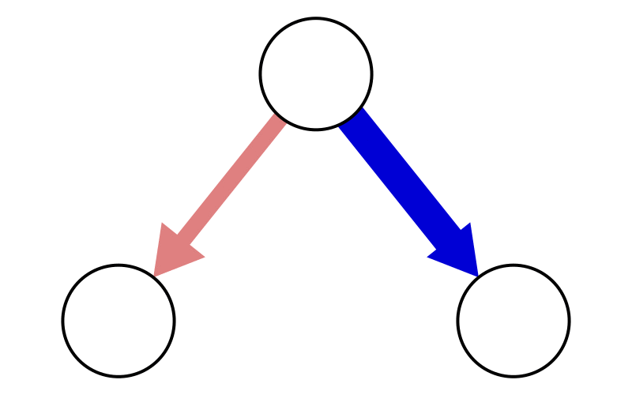
Project I
Project II
Project III
Adaptive assesment
Missing Data
Network Monitoring
4 | ? | ? | 3
6 | 8 | 4 | ?
? | 7 | ? | 2

Slide 31
Project I
Project II
Project III
Adaptive Assesment
Missing Data
Network Monitoring
4 | ? | ? | 3
6 | 8 | ? | ?
? | 7 | ? | 2
Possible without II and III with pre-calibration
Improves network estimation
Also possible with complete data

Slide 32
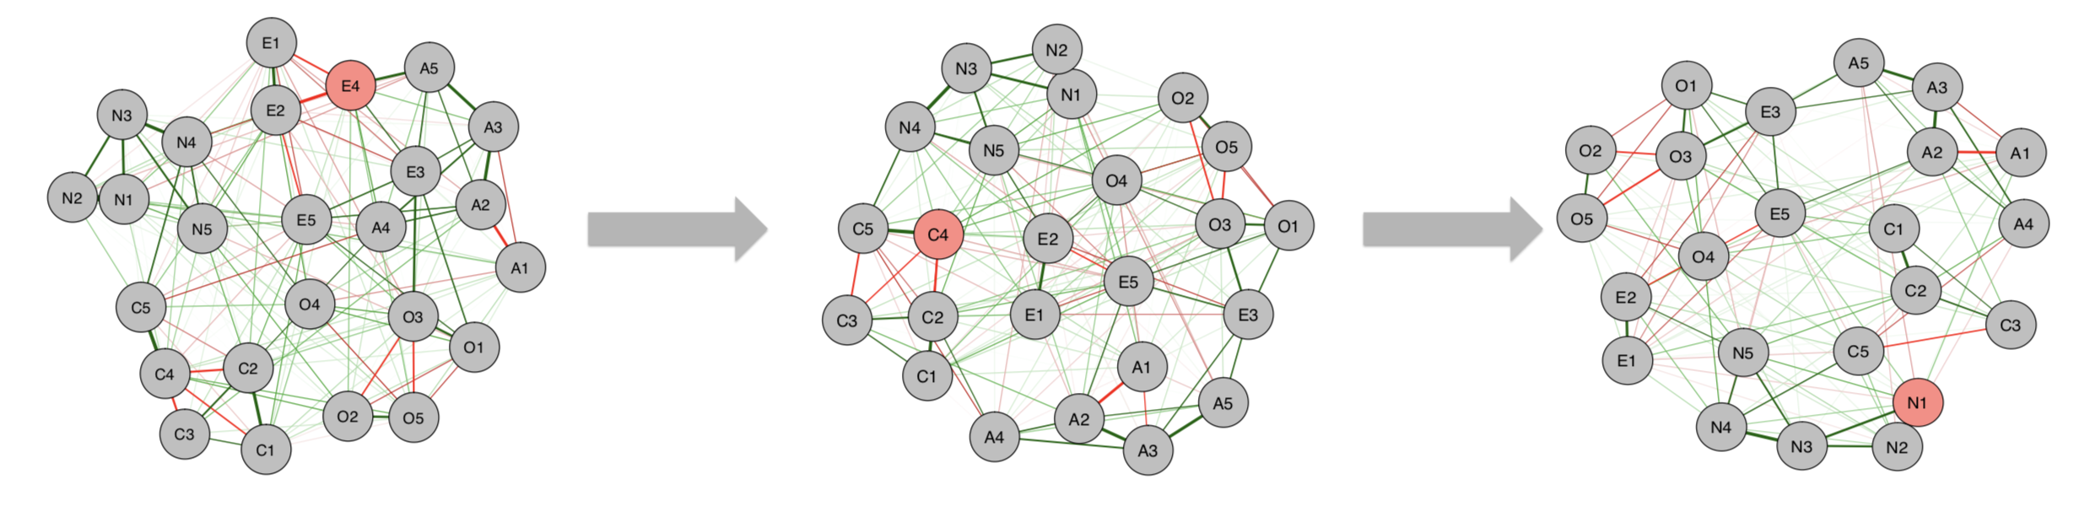
Work by Julian Burger

